Slide 1
HEAR Higher Education Access Route
School Presentation 2024

Slide 2
Would
YOU
like to
go to college?
Where
would
YOU
like to go?

Slide 3
How do
I
get there?
How do
I
apply?

Slide 4
Have you
heard of
HEAR?

Slide 5
What is HEAR?
The Higher Education Access Route is an admissions route for school leavers who for social, financial or cultural reasons are under-represented in third level education.
It was set up to ensure that all Leaving Certificate students have a fair and equal opportunity to progress to third level education.

Slide 6
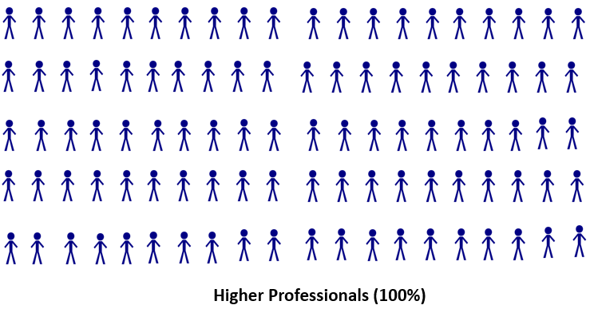
Understanding Socio Economic Group (SEG)
In a typical Leaving Cert Class, the children of Higher Professionals are significantly more likely to go to college than other socio economic groups.
Higher Professionals (100%)
Non Manual Workers (c. 23%)

Slide 7
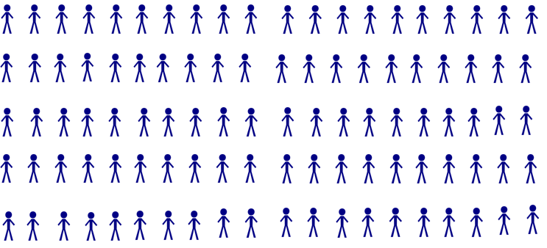
Understanding Area Profile
99% of Students in Dublin 6
go to College compared to
15% in Dublin 17
Dublin 6 (99%)
Dublin 17 (15%)

Slide 8
Where can I go to college?
Maynooth University
Pontifical University
ATU, Donegal
ATU, Sligo
St. Angela’s College, Sligo
Dublin City University
Dundalk Institute of Technology
Institute of Art, Design & Technology, Dún Laoghaire
Marino Institute of Education
National College of Ireland
NCAD
RCSI
Trinity College, Dublin
TU Dublin
University College, Dublin
TUS, Athlone
ATU, Galway
University of Galway
SETU, Carlow and Wexford
TUS, Limerick
Mary Immaculate College
University of Limerick
SETU, Waterford
MTU, Kerry Campus
MTU Cork Campus
University College Cork

Slide 9
Where can I go to college?
www.accesscollege.ie/hear/participating-colleges/

Slide 10
There is something for YOU
in college.

Slide 11
Arts…
Science…
Business…
Engineering…
Health Sciences…
Medicine…
IT…

Slide 12
Clubs & Societies…
Athletics…Gaelic Football…
Mountaineering…Drama…
Film…Dance…
Volunteer…Make a difference.

Slide 13
Applying for a grant
HEAR is NOT
the SUSI grant.
.
If you apply to HEAR,
you should also apply to SUSI
if you think you may be eligible.

Slide 14
SUSI: Key Eligibility Criteria
Nationality: Irish, EU, EEA, Swiss nationals or have specific leave to remain in the State.
Residency: 3 of last 5 years in Ireland, EU, EEA or Switzerland.
Progression in education – NFQ levels 5-10.
Approved College/Course
‘Reckonable’ Income (Class - Dependent/Independent) www.susi.ie/undergraduate-income-threshold-and-grant-award-rates/

Slide 15
SUSI: Key Eligibility Criteria
Check the website: www.susi.ie (Use Eligibility Reckoner)
CAO form: Tick the SUSI option to share your college acceptance
Apply early: April 2024
Return requested documentation: complete and on time
Website: www.susi.ie
Email: support@susi.ie
Facebook.com/susisupport
Twitter.com/susihelpdesk
Telephone helpdesk: 0818 888 777
Contact SUSI

Slide 16
Why apply to HEAR?
Reduced points CAO offers in the participating colleges provided you meet the minimum entry requirements.
Post-entry supports such as financial, academic, social and personal.
Notes:
Use comments from your own students here eg Orientation, etc:
“Orientation was the best, it took the fear out of going to college”
Or
I made new friends and

Slide 17
Benefits of HEAR
Reduced Points
An example: If the Leaving Certificate points for a course are 366 points, an eligible HEAR applicant could be offered a place with a lower points score e.g. 356 points.
Applicants need to meet entry and programme requirements to be considered for a HEAR reduced points offer.
The amount of points a particular course is reduced by is dependent on:
The overall number of places on the course
The number of reserved HEAR places on the course
The number of HEAR eligible applicants competing for these reserved places.
The reduction in points for HEAR places can vary every year.

Slide 18
Should I apply? HEAR Indicators
Was your household income on or below €46,790 in 2022?
Do you or your family have a Medical Card/GP Visit Card?
Did your parents/guardians receive a means-tested social welfare payment for at least 26 weeks in 2022?
Is your parents’ or guardians’ employment status under-represented in Higher Education?
Have you attended a DEIS second level school for five years?
Do you live in an area of concentrated disadvantage?

Slide 19
Talk to your Parent/
Guardian.

Slide 20
You must meet the
HEAR income limit
plus
the right combination
of 2 other indicators to be eligible

Slide 21
How do I apply?
Apply to CAO at www.cao.ie by 1 February 2024.
Review your HEAR Handbook with your parents or guardians.
3. Complete all elements of the online HEAR application form by 17:00 on 1 March 2024.
4. Submit clear copies of supporting documents requested on your checklist to CAO by 15 March 2024.

Slide 22
How do I know what documents I need?
When you fill in your online HEAR application you will receive a checklist at the end. This is based on the information you provided.
The checklist tells you what documents you need to submit to fully complete your HEAR application.
You should start gathering your documentation in a timely fashion, i.e. before 15 February.
Send in all documents requested on the checklist to make a complete application before 15 March 2024.

Slide 23
How do I know what documents I need?
You can start your application as soon as the CAO opens on 6 November 2023.
Do not leave it too late to start looking for the documents you need for your application –
you should start gathering the documents you need before 15 February 2024

Slide 24
Sample Supporting Documents
Statement of Liability or Self Assessment Letter – Chapter 4 for 2022
Social Welfare Form/Statement for 2022 Signed and Stamped by Social Welfare Official
RP50 Notification of Redundancy or
Retirement Lump Sum Letter for 2022
Letter from TUSLA for Children in Care

Slide 25
Helpful Tips
Study the HEAR Handbook carefully with your parents/guardians.
Complete the online application accurately.
Accurate description of Parental Occupation.
Request the required supporting documentation early.
Send good quality copies of all pages of the correct documents.
Submit all supporting documents requested.
Submit correct Revenue documents – eg Statement of Liability
Keep proof of postage.
Deadlines!

Slide 26
Did you know?
The most common reason for ineligible applications to HEAR in 2023 was because the applicant submit the wrong Revenue document.
HEAR seeks financial documents for 2022
- Statement of Liability or
Self-Assessment Letter or
Notice of Assessment
!

Slide 28
What is DARE?
The Disability Access Route to Education (DARE) is a third level alternative admissions scheme for school-leavers whose disabilities have had a negative impact on their second level education.
DARE offers reduced points places to school leavers who as a result of having a disability have experienced additional educational challenges in second level education.

Slide 29
Should I apply?
If your disability has had a negative impact on your educational performance in school.
You may not be able to meet the points for your preferred course due to the impact of your disability.
You are under 23 years of age as at 1 January 2024.

Slide 30
Disabilities eligible for consideration
Autistic Spectrum Disorder (including Asperger’s Syndrome)
ADD/ADHD
Blind/Vision Impaired
Deaf/Hard of Hearing
DCD – Dyspraxia
Dyslexia/Significant Literacy Difficulties
Dyscalculia/Significant Numeracy Difficulties
Mental Health Condition
Neurological Condition (Incl. Brain Injury & Epilepsy)
Speech & Language Communication Disorder
Significant Ongoing Illness
Physical Disability

Slide 31
Educational Impact
Has your disability impacted on a combination of the following?
Have you received intervention or supports in post-primary school?
Has it impacted on your attendance or regularly disrupted your school day?
Has it affected your school experience and well-being?
Has it impacted on your learning or exam results?
Has it caused any other educational impact?
Required for applicants with Dyslexia/ Significant Literacy Difficulties or Dyscalculia/ Significant Numeracy Difficulties: is it severely impacting on your literacy or numeracy skills?

Slide 32
DARE Eligibility Criteria
To be eligible for DARE you must meet both the DARE educational impact criteria and DARE evidence of disability criteria.
Applicants must provide the required evidence of their disability and provide an Educational Impact Statement from their school to be considered for DARE.

Slide 33
How do I apply?
Apply to CAO at www.cao.ie by 17:00 on 1 February 2024.
Review your DARE Handbook with your parents or guardians.
Complete Section A of the Supplementary Information Form(SIF) online and apply to DARE by answering Yes to Question 1 by 17:00 on 1 March 2024.
Submit the Educational Impact Statement and Evidence of Disability to CAO by 15 March 2024.

Slide 34
DARE and HEAR Timelines
DARE & HEAR closing date |  | 1 March 2024 at 17:00
Supporting documents closing date |  | 15 March 2024
Notification of eligibility |  | Late June 2024
Review and Appeals Application |  | Early July 2024
HEAR/DARE offers |  | August 2024
College Orientation |  | Late Aug /Early Sept 2024

Slide 35
Remember
Submit it!
Check it!
Send it!

Slide 36
Remember
You can apply to both DARE & HEAR
Applicants who are both DARE and HEAR eligible will be prioritised by colleges when allocating reduced points places.

Slide 37
Further Information: www.accesscollege.ie

Slide 38
Virtual Application Information Days
Saturday
13 January
2024
10am -2pm

Slide 39
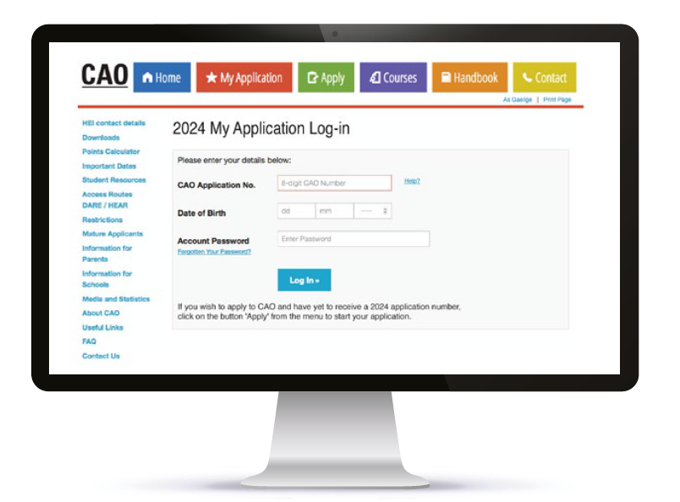
HEAR Application Outcome
You will receive an email notification about your HEAR application outcome once the Leaving Certificate examinations are over in late June.
Log into your CAO application to view your
HEAR Application Outcome.

Slide 40
Further Information
cao.ie
susi.ie
qualifax.ie

Slide 41
Follow us on….
www.accesscollege.ie

