Slide 1
School Presentation for applying to HEAR in 2025

Slide 2
What is HEAR?
The Higher Education Access Route is an admissions route for school leavers who for social, financial or cultural reasons are under-represented in third level education.
It was set up to ensure that all Leaving Certificate students have a fair and equal opportunity to progress to third level education.

Slide 3
Where can I go to college?
Maynooth University
Pontifical University
ATU, Donegal
ATU, Sligo
St. Angela’s College, Sligo
Dublin City University
Dundalk Institute of Technology
Institute of Art, Design & Technology, Dún Laoghaire
Marino Institute of Education
National College of Ireland
NCAD
RCSI
Trinity College, Dublin
TU Dublin
University College, Dublin
TUS, Athlone
ATU, Galway
University of Galway
SETU, Carlow and Wexford
TUS, Limerick
Mary Immaculate College
University of Limerick
SETU, Waterford
MTU, Kerry Campus
MTU Cork Campus
University College Cork

Slide 4
HEAR is about ensuring everyone has access to the course of their dreams.

Slide 5
Why apply to HEAR?
Reduced points CAO offers in the participating colleges provided you meet the minimum entry requirements.
Post-entry supports such as financial, academic, social and personal.

Slide 6
Benefits of HEAR
Reduced Points
An example: If the Leaving Certificate points for a course are 366 points, an eligible HEAR applicant could be offered a place with a lower points score e.g. 356 points.
Applicants need to meet entry and programme requirements to be considered for a HEAR reduced points offer.
The amount of points a particular course is reduced by is dependent on:
The overall number of places on the course
The number of reserved HEAR places on the course
The number of HEAR eligible applicants competing for these reserved places.
The reduction in points for HEAR places can vary every year.

Slide 7
HEAR Indicators
Was your household income on or below €46,790 in 2023?
Do you or your family have a Medical Card/GP Visit Card?
Did your parents/guardians receive a means-tested social welfare payment for at least 26 weeks in 2023?
Is your parents’ or guardians’ employment status under-represented in Higher Education?
Have you attended a DEIS second level school for five years?
Do you live in an area of concentrated disadvantage?

Slide 8
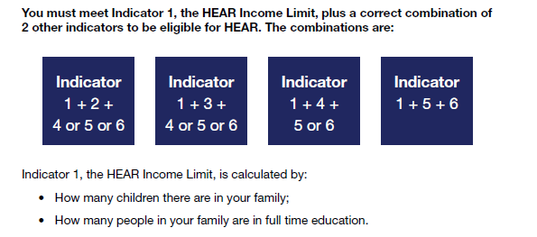
You must meet the HEAR income limit plus the right combination of 2 other indicators to be eligible

Slide 9
How do I apply?
Apply to CAO at www.cao.ie by 1 February 2025.
Review your HEAR Handbook with your parents or guardians.
3. Complete all elements of the online HEAR application form by 17:00 on 1 March 2025.
4. Submit clear copies of supporting documents requested on your checklist to CAO by 15 March 2025.

Slide 10
How do I know what documents I need?
When you fill in your online HEAR application you will receive a checklist at the end. This is based on the information you provided.
The checklist tells you what documents you need to submit to fully complete your HEAR application.
You should start gathering your documentation in a timely fashion, i.e. before 15 February.
Send in all documents requested on the checklist to make a complete application before 15 March 2025.

Slide 11
How do I know what documents I need?
You can start your application as soon as the CAO opens on 5 November 2024.
Do not leave it too late to start looking for the documents you need for your application –
you should start gathering the documents you need before 15 February 2025

Slide 12
Sample Supporting Documents
Statement of Liability or Self Assessment Letter – Chapter 4 for 2023
Social Welfare Form/Statement for 2023 Signed and Stamped by Social Welfare Official
RP50 Notification of Redundancy
Retirement Lump Sum Letter for 2023
Letter from TUSLA for Children in Care

Slide 13
Helpful Tips
Study the HEAR Handbook carefully with your parents/guardians.
Complete the online application accurately.
Accurate description of Parental Occupation.
Request the required supporting documentation early.
Send good quality copies of all pages of the correct documents.
Submit all supporting documents requested.
Submit correct Revenue documents – e.g. Statement of Liability
Keep proof of postage.
Deadlines!

Slide 14
Did you know?
The most common reason for ineligible applications to HEAR in 2024 was because the applicant submitted the wrong Revenue document.
HEAR seeks financial documents for 2023
- Statement of Liability or Self-Assessment Letter or Notice of Assessment
!

Slide 15
School Presentation for applying to DARE in 2025

Slide 16
What is DARE?
The Disability Access Route to Education (DARE) is a third level alternative admissions scheme for school-leavers whose disabilities have had a negative impact on their second level education.
DARE offers reduced points places to school leavers who as a result of having a disability have experienced additional educational challenges in second level education.

Slide 17
Should I apply?
If your disability has had a negative impact on your educational performance in school.
You may not be able to meet the points for your preferred course due to the impact of your disability.
You are under 23 years of age as of 1 January 2025.

Slide 18
Disabilities eligible for consideration
Autistic Spectrum Disorder (including Asperger’s Syndrome)
ADD/ADHD
Blind/Vision Impaired
Deaf/Hard of Hearing
DCD – Dyspraxia
Dyslexia/Significant Literacy Difficulties
Dyscalculia/Significant Numeracy Difficulties
Mental Health Condition
Neurological Condition (Incl. Brain Injury & Epilepsy)
Physical Disability
Significant Ongoing Illness
Speech & Language Communication Disorder

Slide 19
Educational Impact
Has your disability impacted on a combination of the following?
Have you received intervention or supports in post-primary school?
Has it impacted on your attendance or regularly disrupted your school day?
Has it affected your school experience and well-being?
Has it impacted on your learning or exam results?
Has it caused any other educational impact?
Required for applicants with Dyslexia/ Significant Literacy Difficulties or Dyscalculia/ Significant Numeracy Difficulties: is it severely impacting on your literacy or numeracy skills?

Slide 20
DARE Eligibility Criteria
To be eligible for DARE you must meet both the DARE educational impact criteria and DARE evidence of disability criteria.
Applicants must provide the required evidence of their disability and provide an Educational Impact Statement from their school to be considered for DARE.

Slide 21
How do I apply?
Apply to CAO at www.cao.ie by 17:00 on 1 February 2025.
Review your DARE Handbook with your parents or guardians.
Complete Section A of the online Supplementary Information Form(SIF) and apply to DARE by answering Yes to Question 1 by 17:00 on 1 March 2025.
Submit the Educational Impact Statement and Evidence of Disability to CAO by 15 March 2025.

Slide 22
DARE and HEAR Timelines
DARE & HEAR closing date: |  | 1 March 2025 at 17:00
Supporting documents closing date: |  | 15 March 2025
Notification of eligibility: |  | Late June 2025
Review and Appeals Application: |  | Early July 2025
HEAR/DARE offers: |  | August 2025
College Orientation: |  | Late Aug /Early Sept 2025

Slide 23
Remember… Submit it! Check it! Send it!

Slide 24
Remember… You can apply to both DARE & HEAR
Applicants who are both DARE and HEAR eligible will be prioritised by colleges when allocating reduced points places.

Slide 25
Further Information: www.accesscollege.ie

Slide 26
In person Application Information Days
Saturday
11 January 2025
10am -2pm
Visit the Access College website to see which local college is open for you to attend!

Slide 27
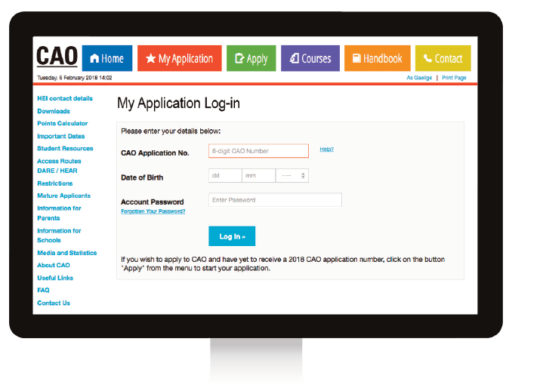
HEAR Application Outcome
You will receive an email notification about your HEAR application outcome once the Leaving Certificate examinations are over in late June.
Log into your CAO application to view your
HEAR Application Outcome

Slide 28
Applying for a grant
Just remember HEAR is NOT the SUSI grant.
If you apply to HEAR, you should also apply to SUSI if you think you may be eligible.

Slide 29
SUSI: Key Eligibility Criteria
Nationality: Irish, EU, EEA, Swiss nationals or have specific leave to remain in the State.
Residency: 3 of last 5 years in Ireland, EU, EEA or Switzerland.
Progression in education – NFQ levels 5-10.
Approved College/Course
‘Reckonable’ Income (Class - Dependent/Independent) www.susi.ie/undergraduate-income-threshold-and-grant-award-rates/

Slide 30
SUSI: Key Eligibility Criteria
Check the website: www.susi.ie (Use Eligibility Reckoner)
CAO form: Tick the SUSI option to share your college acceptance
Apply early: April 2025
Return requested documentation: complete and on time
Website: www.susi.ie
Email: support@susi.ie
Facebook.com/susisupport
Twitter.com/susihelpdesk
Telephone helpdesk: 0818 888 777

Slide 31
Next Steps:
Begin to discuss making an application to HEAR with your Guidance counsellor, parents or guardians
Begin to collect relevant documents
Reach out to the local disability and access office in the college you hope to attend, they want to help you!

Slide 32
www.accesscollege.ie

