Slide 1

School Presentation for applying to DARE in 2026

Slide 2

The Disability Access Route to Education (DARE) is a third level alternative admissions scheme for school-leavers whose disabilities have had a negative impact on their second level education.
DARE offers reduced points places to school leavers who as a result of having a disability have experienced additional educational challenges in second level education.
What is DARE?

Slide 3


DARE is about making sure every student has a fair chance to follow their dreams!
It was created to ensure all Leaving Certificate students can access higher education on an equal footing.

Slide 4
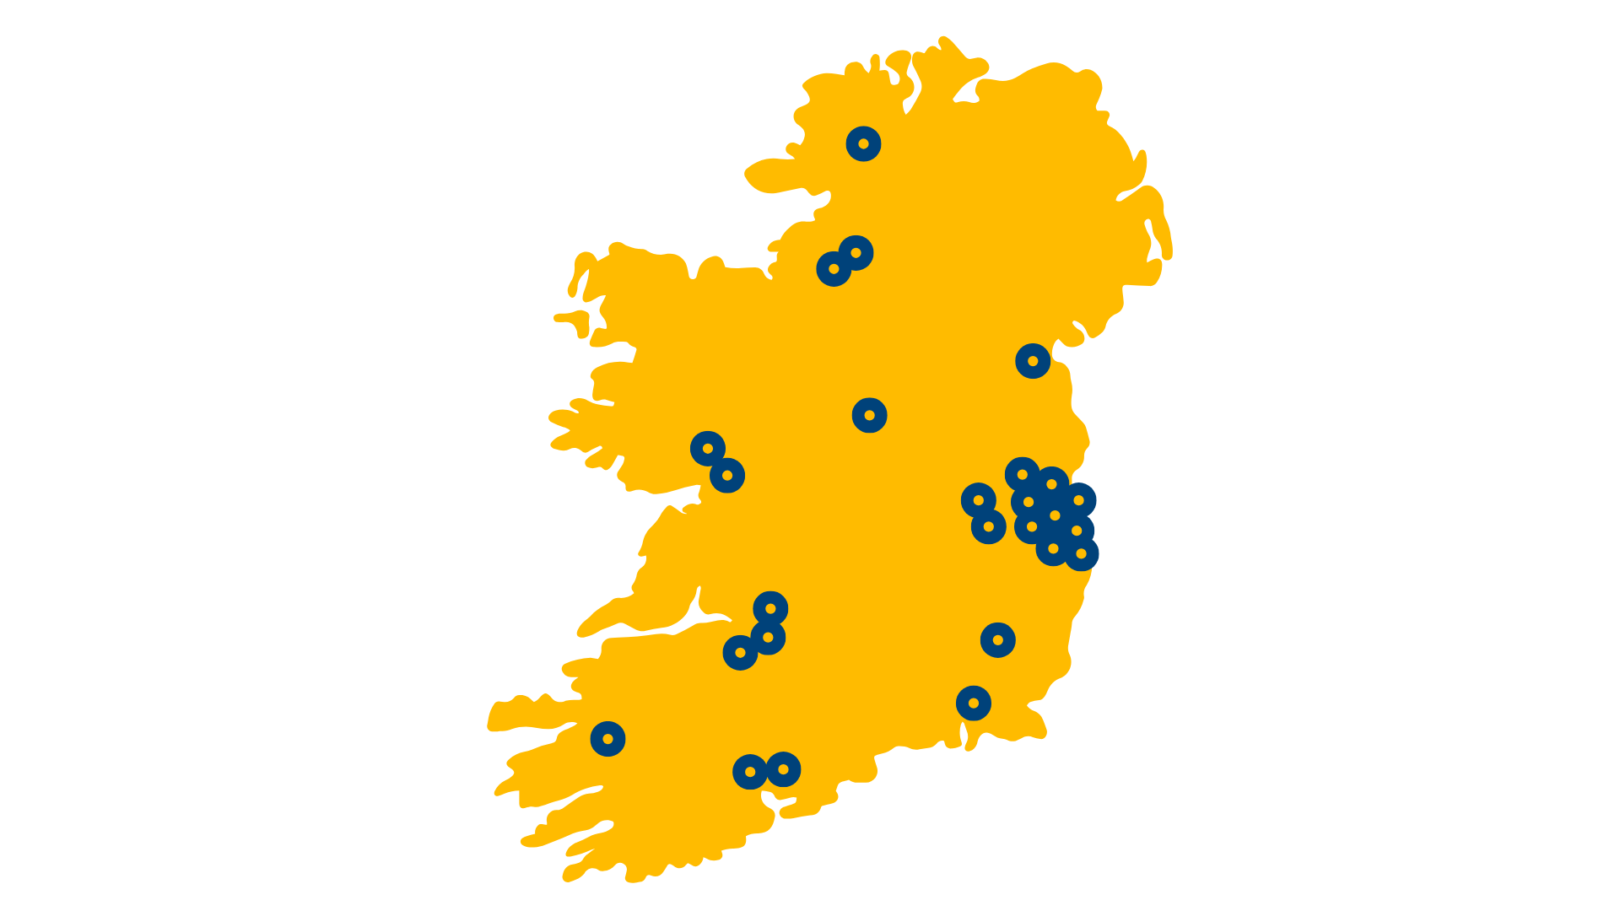
Where can I go to college?
Atlantic Technological University
Donegal Campus
Galway Campus
Sligo Campus
St Angela’s College
Dublin City University
Dun Laoghaire Institute of Art, Design and Technology
Dundalk Institute of Technology
Marino Institute of Education
Mary Immaculate College
Maynooth University
Munster Technological University
Cork Campus
Kerry Campus
National College of Art & Design
National College of Ireland
Pontifical University, Maynooth
RCSI University of Medicine & Health Sciences
South East Technological University
Carlow and Wexford Campus
Waterford Campus
Technological University Dublin
Technological University of the Shannon
Athlone Campus
Limerick Campus
Trinity College Dublin
University College Cork
University College Dublin
University of Galway
University of Limerick

Slide 5

Should I apply?
If your disability has had a negative impact on your educational performance in school.
You may not be able to meet the points for your preferred course due to the impact of your disability.
You are under 23 years of age as of 1 January 2026.

Slide 6
Disabilities eligible for consideration
Autistic Spectrum Disorder (including Asperger’s Syndrome)
ADD/ADHD
Blind/Vision Impaired
Deaf/Hard of Hearing
DCD – Dyspraxia
Dyslexia/Significant Literacy Difficulties
Dyscalculia/Significant Numeracy Difficulties
Mental Health Condition
Neurological Condition (Incl. Brain Injury & Epilepsy)
Physical Disability
Significant Ongoing Illness
Speech & Language Communication Disorder

Slide 7
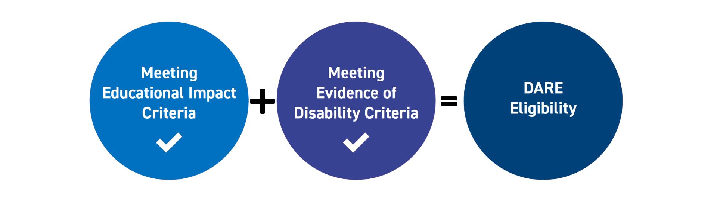
DARE Eligibility Criteria
Applicants must provide the required evidence of their disability and provide an Educational Impact Statement from their school to be considered for DARE.

Slide 8
Educational Impact
Has your disability impacted on a combination of the following?
Have you received intervention or supports in post-primary school?
Has it impacted on your attendance or regularly disrupted your school day?
Has it affected your school experience and well-being?
Has it impacted on your learning or exam results?
Has it caused any other educational impact?
Required for applicants with Dyslexia/ Significant Literacy Difficulties or Dyscalculia/ Significant Numeracy Difficulties: is it severely impacting on your literacy or numeracy skills?

Slide 9
Benefits of DARE
Reduced Points
An example: If the Leaving Certificate points for a course are 366 points, an eligible DARE applicant could be offered a place with a lower points score e.g. 356 points.
Applicants need to meet entry and programme requirements to be considered for a DARE reduced points offer.
The amount of points a particular course is reduced by is dependent on:
The overall number of places on the course
The number of reserved DARE places on the course
The number of DARE eligible applicants competing for these reserved places.
The reduction in points for DARE places can vary every year.

Slide 10
Benefits of DARE in college
Orientation Programmes
Learning Support
Assistive Technology
Library Support
Exam Accommodations
Educational Support Worker
Academic Tuition
You don’t have to be eligible for DARE to get support in college.
A needs assessment is conducted to identify your specific support requirements.

Slide 11
How do I apply?
Apply to CAO at www.cao.ie by 17:00, 1 February 2026.
Review your DARE Handbook with your parents or guardians.
Complete Section A, the online Supplementary Information Form (SIF) and apply to DARE by answering Yes to Question 1 by 1 March 2026.
You should start gathering your documentation in a timely fashion, i.e. before 15 February.
Submit the Educational Impact Statement and Evidence of Disability to CAO by post by 10 March 2026.

Slide 12
Section A: Supplementary Information Form (SIF)
Section A: Applicant Information
Completed by you online by 17:00 on 1 March 2026.
Answer Yes to Q1 to apply to DARE and fully complete Questions 1-5. OR
Answer Yes to Q1(b) to apply to carry forward your DARE eligibility from 2025 to 2026.
Section B: Educational Impact Statement (EIS)
Educational Impact Statement completed by your school. Send to CAO by post by 10 March 2026.
Section C: Evidence of a Disability (EOD)
Completed by the appropriate professional. Send to CAO by post by 10 March 2026.
Section D: School Statement
Where applying under the Dyslexia/ Significant Literacy Difficulties category, applicants who do not have a Psychological Assessment Report identifying Dyslexia should submit Section D School Statement. Send to CAO by post by 10 March 2026.

Slide 13

Section B: Educational Impact Statement (EIS)
Provides information on how your disability has impacted on your second level education.
Download form.
Complete the Educational Impact Statement (EIS) Checklist with your school.
Your school will complete the rest following on from your responses to the EIS Checklist.
This form needs to be completed by either your:
Guidance Counsellor
Learning Support Teacher
Year Head
Visiting Teacher or
Principal/Deputy Principal
The form MUST BE signed and stamped by school Principal/Deputy Principal. You must post Section B Educational Impact Statement (EIS) to the CAO by 10 March 2026

Slide 14
Section C: Evidence of Disability (EOD)
Provides verification of your disability and helps to determine 3rd level supports.
You can provide an existing report
OR
Complete Section C Evidence of Disability Form 2026.
Get the form completed, signed and stamped by the appropriate professional or accompanied by their business card or headed paper.
Applicants with Dyslexia/Significant Literacy Difficulties or Dyscalculia/Significant Numeracy Difficulties are asked to provide a full psychological assessment of any age completed by an appropriately qualified psychologist instead of the Section C Evidence of Disability form. Where applying under the Dyslexia/ Significant Literacy Difficulties category, applicants who do not have a Psychological Assessment Report identifying Dyslexia should submit Section D School Statement.

Slide 15

Section C: Evidence of Disability (EOD)
GP Verification
Your GP may be in a position to complete Section C Evidence of Disability, if they have the appropriate information on file from the Consultant/Specialist.
Age of Reports
It is important to note that applicants applying under the following disability categories must provide a report that is less than 3 years old, i.e. dated after 1 February 2023.
ADD/ADHD
Mental Health Condition
Significant Ongoing Illness

Slide 16
Section C: Evidence of Disability (EOD)
Psychological Assessment
Applicants with Dyslexia/Significant Literacy Difficulties or Dyscalculia/Significant Numeracy Difficulties must provide a full Psychological Assessment Report of any age completed by a psychologist.
Where applying under the Dyslexia/ Significant Literacy Difficulties category, applicants who do not have a Psychological Assessment Report identifying Dyslexia should submit Section D School Statement in support of their application.
AND
Applicants with Dyslexia/Significant Literacy Difficulties MUST also have two literacy attainment scores at or below the 10th percentile (Standard Score of 81 or below).
Applicants with Dyscalculia/Significant Numeracy Difficulties MUST also have one numeracy attainment score at or below the 10th percentile (Standard Score of 81 or below).

Slide 17

Section C: Evidence of Disability (EOD)
Continued
These attainment scores can be from one (or a combination) of the following sources:
1) Scores from school-based attainment testing.
2) Scores from attainment tests carried out by a psychologist.
Testing must have been carried out on or after 1 February 2024 and all applicants must submit an EIS completed by their school.
You must post Evidence of Disability documentation to the CAO by 10 March 2026.
Please keep a copy of all documents that you post to CAO.

Slide 18

Section D: School Statement
If you are applying under the Dyslexia / Significant Literacy Difficulties Category but you do NOT have a Psychological Assessment Report identifying Dyslexia, then submit Section D School Statement.
Ensure that this is signed and stamped by the Special Educational Needs (SEN) Teacher and countersigned by the Principal/Deputy Principal.
You must post Section D School Statement to the CAO by 10 March 2026.

Slide 19
Helpful Tips
Study the DARE Handbook carefully with your parents / guardians.
Apply to the CAO before 5pm on 1 February 2026.
Disclose your disability in your CAO application and no later than 5pm on 1 March 2026 - select ‘Yes’ to Question 1 on the SIF (Save & submit).
Ensure you speak to your Teacher early about the Educational Impact Statement.
Request the required supporting documentation early.
Send good quality copies of all pages of the correct documents.
Post all supporting documents requested to CAO by 10 March.
Make note of the deadlines!
Keep proof of postage.

Slide 20
Common Mistakes that affect DARE Eligibility
Where the Section C form (Evidence of Disability) is completed by GP BUT the required copy of report by appropriate professional confirming diagnosis was not provided.
Reports out of date
Reports not confirming diagnosis of condition by consultant
Incorrect professional completing Section C form or Evidence of Disability Report
Test details missing (for example the name of the test, date or who conducted the test)
Forgetting to complete Question 1 of the Supplementary Information Form by 17:00 on 1 March

Slide 21

DARE and HEAR Timelines
1 February 2026 at 17:00
Must have applied to CAO
1 March 2026 at 17:00
DARE & HEAR closing date
10 March 2026
Supporting documents closing date
Late June 2026
Notification of eligibility
Early July 2026
Review and Appeals Application
August 2026
HEAR/DARE offers
Late Aug /Early Sept 2026
College Orientation

Slide 22
DARE Application Outcome
You will receive an email notification about your DARE application outcome once the Leaving Certificate examinations are over in late June.
Log into your CAO application to view your DARE Application Outcome.

Slide 23
Remember…
You can apply to both DARE & HEAR

Slide 24

Do you need help with your DARE Application?
Each DARE participating college and university has a DARE Representative to help you through the process. You can seek their assistance for the following:
Understanding the DARE criteria
General queries relating to DARE
Providing guidance to applicants and their parents/guardians
Answering queries on disability supports in their setting
Providing clarity on the outcomes process
- Leading the transition and orientation programmes in their setting
For HEI contact details please visit the Access College website.

Slide 25


DARE is NOT the SUSI grant. If you apply to DARE, you should also apply to SUSI if you think you may be eligible.
SUSI: Key Eligibility Criteria
Nationality: Irish, EU, EEA, Swiss nationals or have specific leave to remain in the State.
Residency: 3 of last 5 years in Ireland, EU, EEA or Switzerland.
Progression in education – NFQ levels 5-10.
Approved College/Course
‘Reckonable’ Income (Class - Dependent/Independent)
Check the website: www.susi.ie (Use Eligibility Reckoner)
CAO form: Tick the SUSI option to share your college acceptance
Apply early: April 2026
Return requested documentation: complete and on time
susi.ie

Slide 26


You can find more information on:
www.accesscollege.ie

