Slide 1
Applying to CAO

Slide 2

﻿Purpose of the CAO
﻿CAO processes applications to undergraduate courses
in Higher Education Institutions (HEIs).
Offers are issued and acceptances are recorded by CAO.
Assessment of applications and decisions on
admissions are made by HEIs Admissions Officers.

Slide 3

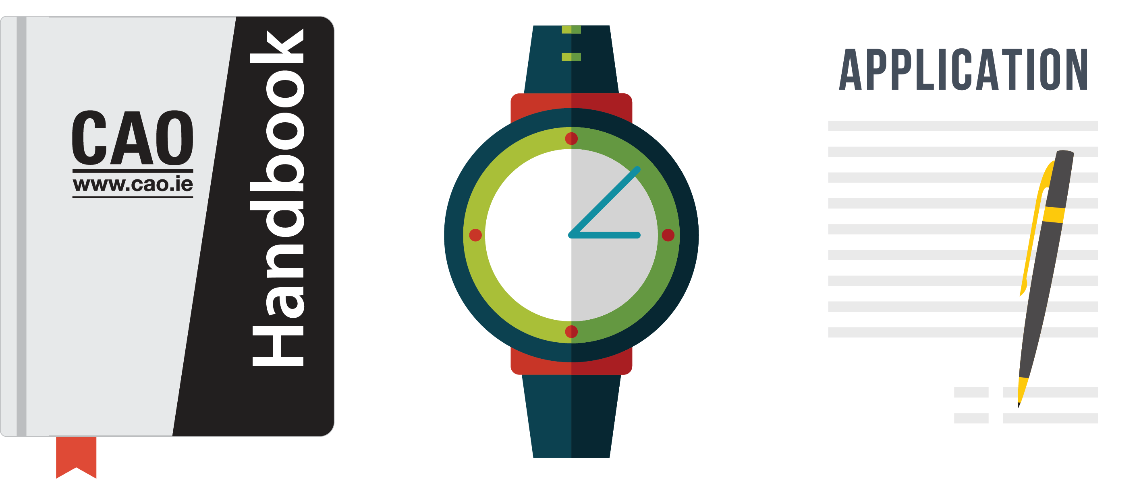
﻿Application Process
www.cao.ie/handbook
www.cao.ie/apply

Slide 4

﻿Timely Action
﻿DO NOT LEAVE
EVERTHING TO
THE LAST
MINUTE!
﻿In order to be fair to all applicants, closing dates
are strict and therefore action should be taken
in good time.

Slide 5
﻿Restrictions
﻿﻿﻿RESTRICTED COURSES
MATURE APPLICANTS
﻿﻿HEAR
SOCIO-ECONOMIC DISADVANTAGE
﻿DARE
DISABILITIES/SLD
﻿Applications must be made by 1 February at 5pm. Consult CAO Handbook for full details.

Slide 6
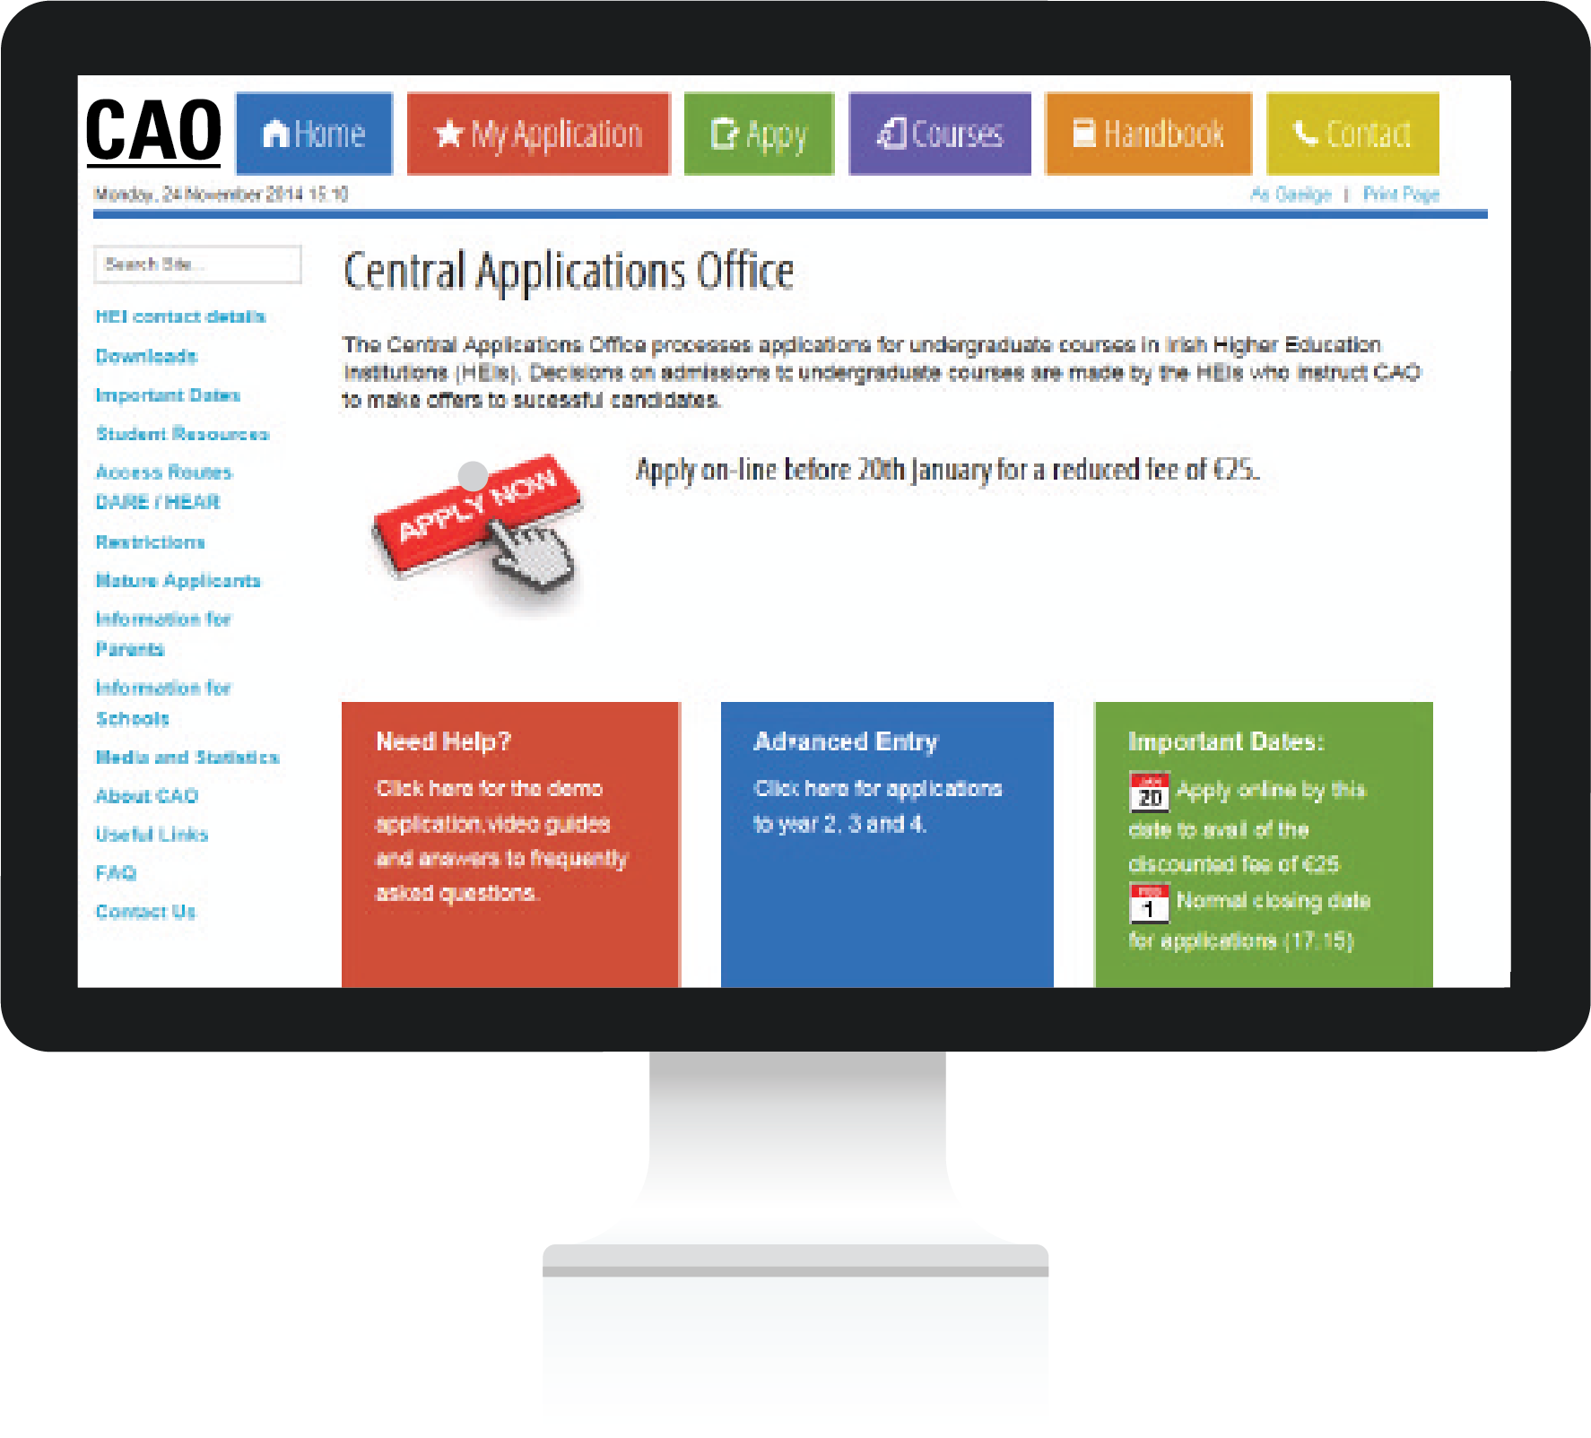
﻿Making an Application
﻿Applicants apply online at www.cao.ie/apply
﻿Carefully enter details such as your name, address, date of birth, schools attended, examination information, etc.
﻿Make sure you inform CAO about all relevant qualifications and exemptions – select the relevant section(s) on the application form.

Slide 7

﻿CAO Application Number
When you apply online your application number will appear on screen. You will also receive an email containing your CAO application number and an email verification code.
Your application number is private, and it will be used in every correspondence between you and the CAO for the rest of the year.
You will require your CAO application number, date of birth and password when you log in to your account via the ‘My Application’ facility to update your application.

Slide 8
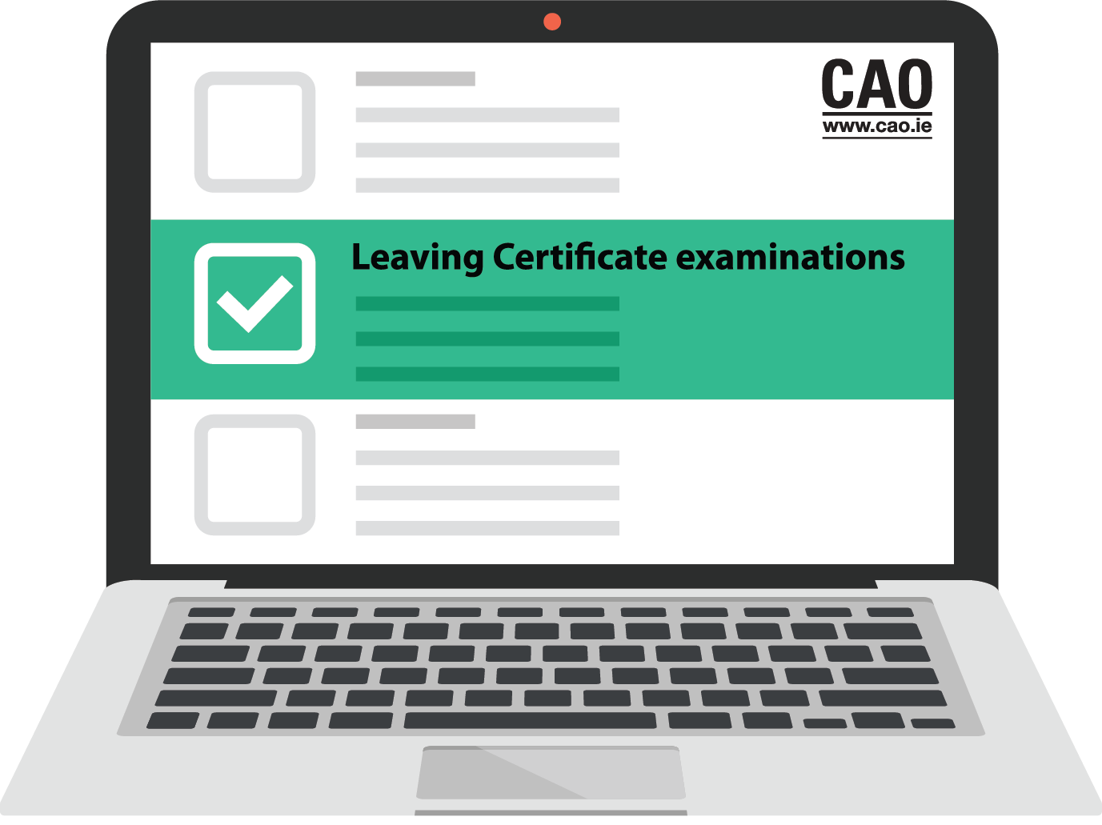
﻿Qualifications & Assessment
You must complete the Qualifications and Assessments section(s) that is relevant to you.
﻿For example, if you are a first-time Leaving Certificate candidate under the age of 23 with no other relevant qualifications, you will be asked to enter your school's name and address and the years attended. You must also tick the Leaving Certificate examinations box and subsequently indicate the year of your Leaving Certificate.
If you have a previous sitting of the Leaving Certificate, you must also remember to supply the year and examination number in the space provided on the application form.

Slide 9

﻿Choosing Courses
Consult your Guidance Counsellor.
Discuss your options with family and friends.
Details about courses may be found in HEI prospectuses and by consulting HEI websites.
A course search facility is available at www.cao.ie/courses

Slide 10

﻿Level 8 and Level 7/6 lists (Course Choices)
There are 2 course choice lists (Level 8 and Level 7/6) and applicants may make up to 10 course choices on each list.
Your choices on one list do not in any way affect your choices on the other list. They may be considered two separate applications on one form.
It is possible to receive an offer on both lists. You may then decide to accept either your Level 7/6 or your Level 8 offer.
Alternatively, you might not wish to accept either offer.

Slide 11
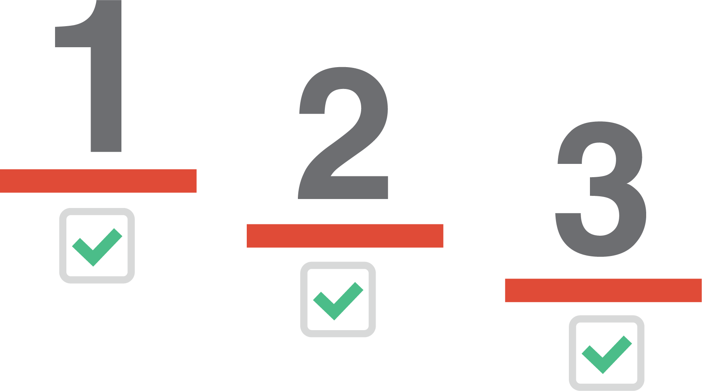

﻿Order of Preference
﻿If you learn nothing else from this presentation let it be this...
﻿PLACE YOUR COURSES IN GENUINE ORDER OF PREFERENCE!
﻿To do otherwise is a grave mistake.

Slide 12

﻿Change of Mind Facility
﻿You may use this facility to change the order of your course choices and/or to introduce new courses, subject to the restrictions detailed in the handbook.
The Change of Mind opens in early May and closes on the 1st of July at 5pm.

Slide 13

﻿Check and Confirm Email
﻿Before the end of May, you will be sent a Check and Confirm email from CAO. The purpose of this e-mail is to instruct you to log in and verify that all of your information has been recorded completely and correctly on your CAO account. There may be very serious consequences for your application if you do not follow these instructions immediately.
Check the following carefully, and if there is any error or omission amend the Statement and return it to CAO.
﻿If you do not
receive the email by
Are your exam numbers correct? (do not assume that they are)
Are all exams mentioned?
Are all exemptions listed?
Are all the courses shown and in the correct order?
contact CAO immediately.

Slide 14
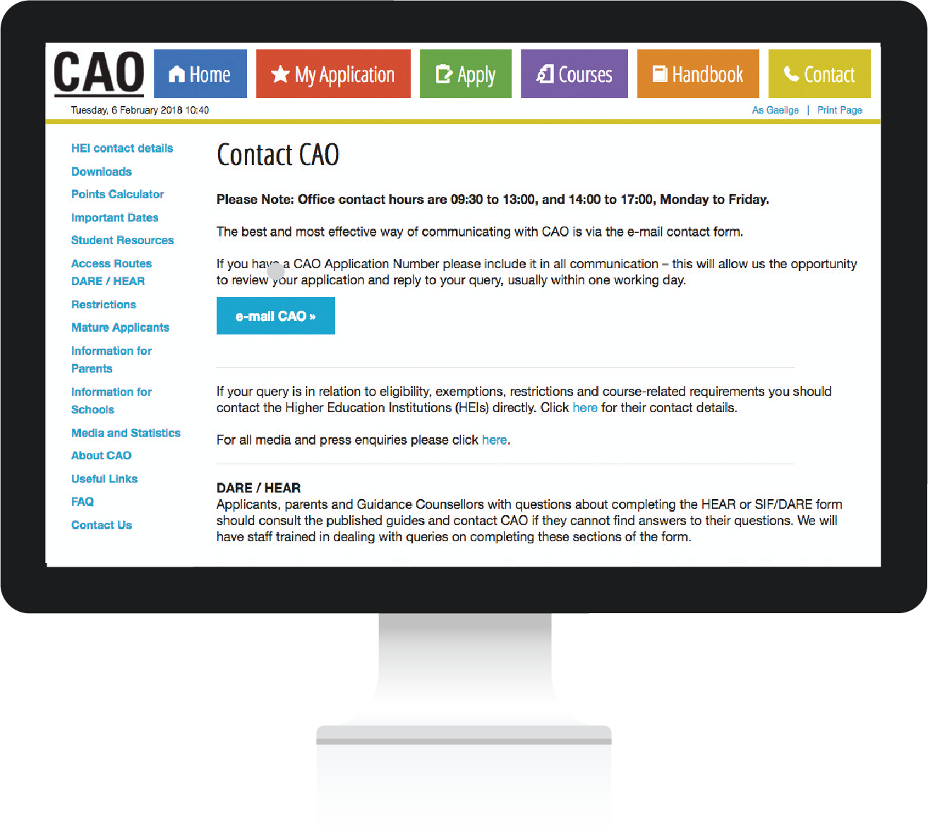
﻿Check for emails from CAO
Please make sure to regularly check the e-mail account that you used when registering with CAO for new emails from CAO containing important information and instructions.
You should periodically check your spam, bulk, promotional or junk mail folders, etc. If you find emails from CAO or HEIs are being directed to these folders, you should consider adding these email addresses to your contacts or email address book.
You should also check the Correspondence section of your account which contains a log of all emails sent to you by CAO, and any online queries that you have submitted to CAO whilst logged in to your application.

Slide 15

﻿The Offer Process
Following the release of the Leaving Certificate results CAO will send a communication to all applicants.
If you have not yet become entitled to an offer in Round A, Round 0 or Round 1, you will be sent a Statement of Application email asking you to check your account information carefully as important information may be incorrect or missing.

Slide 16
﻿Checking for Offers
Offers will also be available on the CAO website.
You may check for and accept offers on the website.
﻿If you are entitled to an offer, you will be sent an email with details of your offer(s).
You will also receive an SMS text message if you have selected this option.
You should check that all of the details in your CAO Account are correct and that there are no errors or omissions.

Slide 17

Accepting an Offer
﻿There can be no delays at the offer/acceptance stage.
Any offer not accepted by the closing date for receipt of acceptance of offers in CAO may be offered to another applicant in the next round of offers.
You will receive an e-mail acknowledging your acceptance.

Slide 18
﻿How Offers are Issued
﻿We will look just at Level 8 courses, but exactly the same process will take place with Level 7/6 courses, and at the same time.
The importance of you, the applicant, placing courses in genuine order of preference will become apparent in the following pages.

Slide 19

Minimum Entry Requirements
﻿When examination results are released, they are entered into the CAO computer.
The computer checks each applicant’s results.
For each course that you have applied for,
the computer first determines if you have met the minimum entry requirements for the course.

Slide 20
﻿Order of Merit List
﻿If you meet the minimum entry requirements for the course, your points are calculated for this course choice.
﻿
﻿
All eligible applicants are then placed on a list, in order of academic merit, for each course that they have applied for.
Minimum Entry Requirements + Points Score = Position on Order of Merit List

Slide 21

Allocation of Places
﻿The admissions officers of the Higher Education Institutions tell CAO how many places are to be offered on each course.
CAO then makes offers to the required number of applicants on each course, starting with the applicant with the highest points and working down until enough places have been offered.

Slide 22

Additional Offer Rounds
﻿﻿Should some applicants decline to accept their offers, these places become available in the next round of offers.
They will be offered to the next applicants on the Order of Merit list.
This process continues until all of the places on the course are filled or until all of the eligible applicants on the Order of Merit list have been offered places.

Slide 23

The Offer Process - Example
﻿EXAMPLE
– no results yet!
﻿These are the applicants for CK101 - Arts in UCC.
The examination results have not yet been released, so these applicants are in no particular order.
We are going to trace the progress of the applicant marked in red.

Slide 24
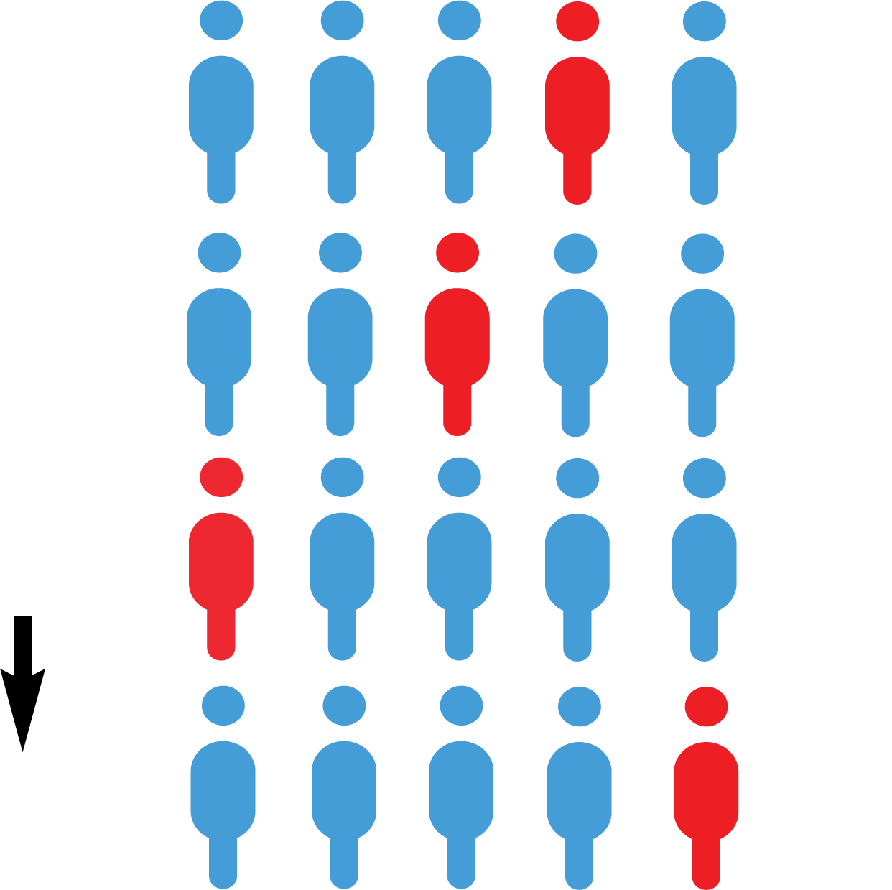
﻿After the Results are Released
﻿EXAMPLE
– LC results have been released.
﻿1. CK101
﻿2. DN201
﻿Applicants are placed in a queue for each course they applied for. Their position in the queue is determined by their points.
The applicant with the highest points is placed at the top of the queue.
The points achieved by the applicant in red determines her position in the queue for each course she has applied to.
﻿3. DK801
﻿10. LM040

Slide 25

﻿Round 1 Offers
﻿EXAMPLE
– HEIs issue R1 offers
﻿1. CK101
﻿2. DN201
﻿The applicants marked in GREEN have enough points to be offered places.
The applicant marked in RED has enough points for her second preference.
﻿3. DK801
﻿10. LM040

Slide 26

﻿Round 1 Offers – contd.
﻿1. CK101
﻿EXAMPLE
– HEIs issue R1 offers
﻿1. CK101
﻿2. DN201
﻿﻿The applicant in RED is offered her second preference, the highest preference course that she has enough points for, and she will now disappear from the queue for all her lower choices.
Placing DN201 as her second preference meant that she would prefer to receive an offer on DN201 than on any other course except CK101 - which is her first preference.

Slide 27

﻿Round 2 Offers
﻿1. CK101
﻿EXAMPLE – R2 offers
﻿1. CK101
﻿After Round 2 offers are issued, our applicant is now in first place on the waiting list for her first preference course.
She has already accepted her 2nd preference course. Accepting or not accepting her 2nd preference course will not prevent her from receiving an offer of her 1st preference course if she is deemed eligible by the institution in a later round.

Slide 28

﻿Round 3 Offers
﻿1. CK101
﻿EXAMPLE – An offer is issued in R3 for her 1st preference!
﻿1. CK101
﻿In the third round of offers, two more offers are made on CK101 and our applicant, who was at the top of the queue, now receives an offer.
She may do nothing and remain in DN201, or she may accept the offer.

Slide 29

﻿Genuine Order of Preference
﻿You do not need to guess what the points are going to be for the courses you are interested in.
Simply list your courses in genuine order of preference from the highest preference 1, to the lowest preference 10.
If you are entitled to an offer, you will be offered the highest preference that you are entitled to.

Slide 30
﻿Have a question?
Please check the ‘Have a question’ page before submitting an email to CAO.
If your question is not answered in the Have a Question page, the easiest and most efficient way to communicate with CAO is by using the Correspondence Section of your CAO Account.
If you post something to CAO always obtain a certificate of posting at the post office. This is a free service, and it offers you peace of mind.

Slide 31
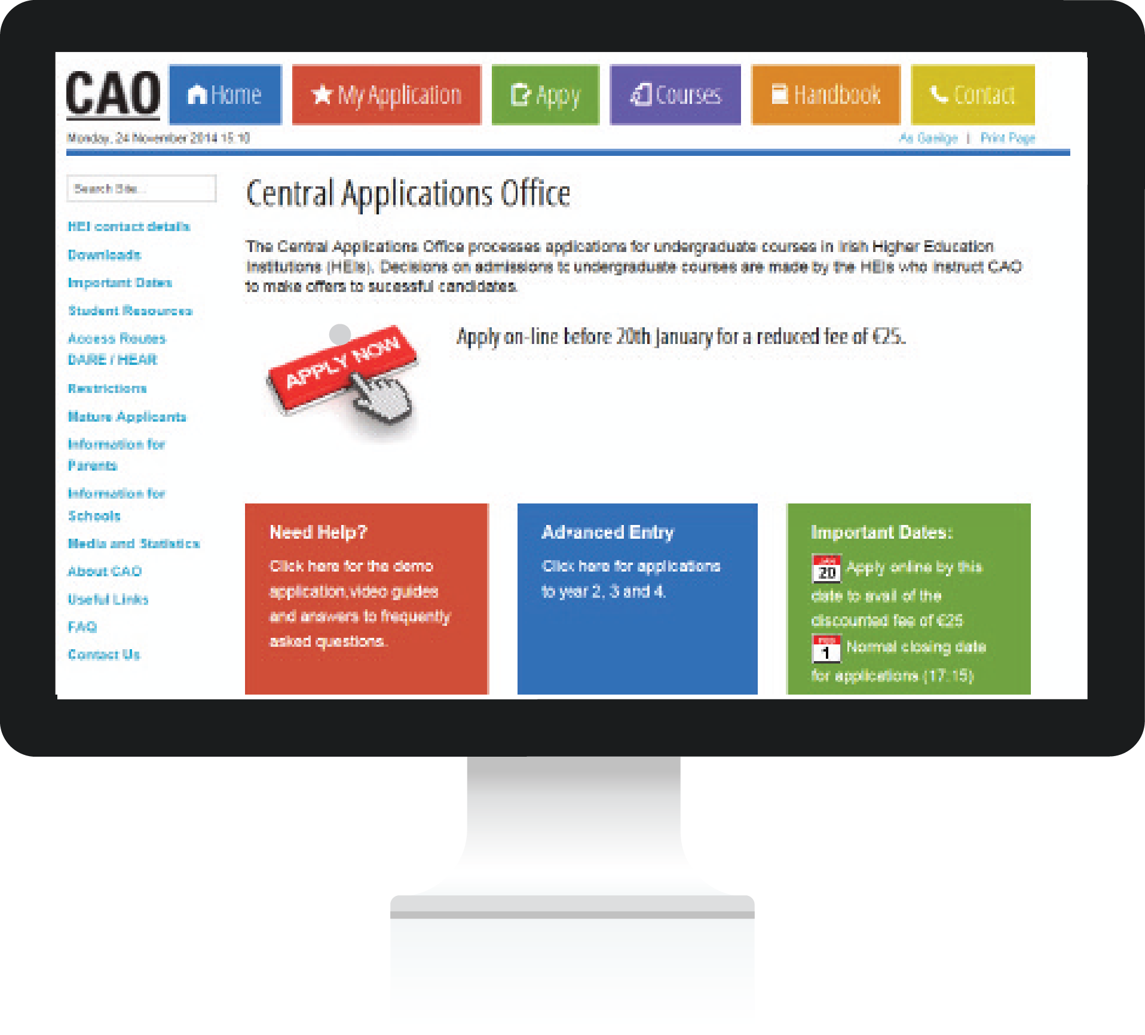
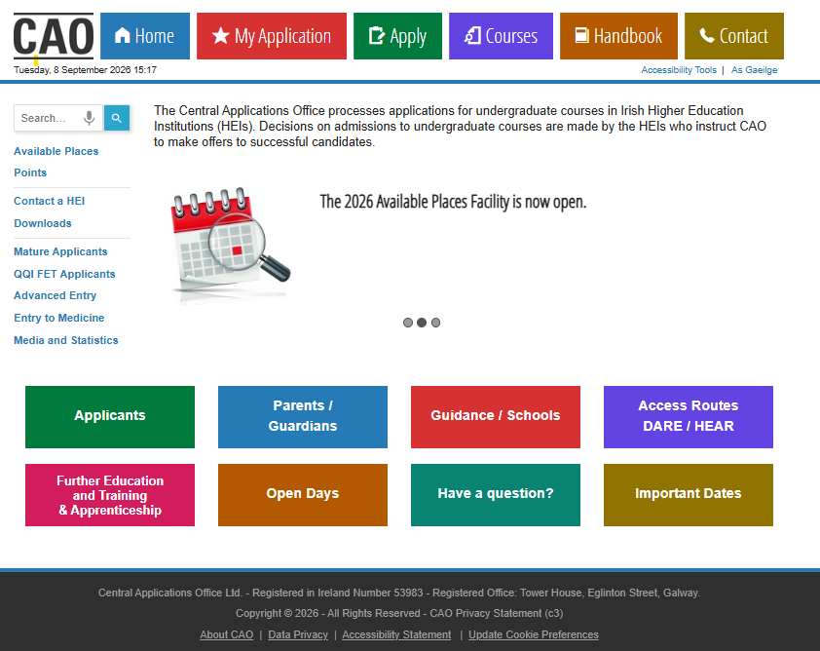
﻿Useful Resources
﻿The personalised
CAO Handbook is
available here
﻿﻿Visit the ‘Applicants’ section accessible here for Video Guides and useful resources including the ‘Demo Application’ facility.
﻿Watch this space for
‘Important Dates’.

Slide 32

﻿Finally...
﻿Remember to carefully
read all of the documents and instructions
from CAO.
﻿Most applicants follow
the simple instructions
from CAO and get
along just fine.
﻿If you are unclear on any matter concerning the application process, please contact us at: www.cao.ie/contact

