Slide 1
Applicants presenting GCE A/AS Level and GCSE qualifications

Slide 2

﻿Purpose of the CAO
﻿CAO processes applications to undergraduate courses
in Higher Education Institutions (HEIs).
Offers are issued and acceptances are recorded by CAO.
Assessment of applications and decisions on
admissions are made by HEI Admissions Officers.

Slide 3

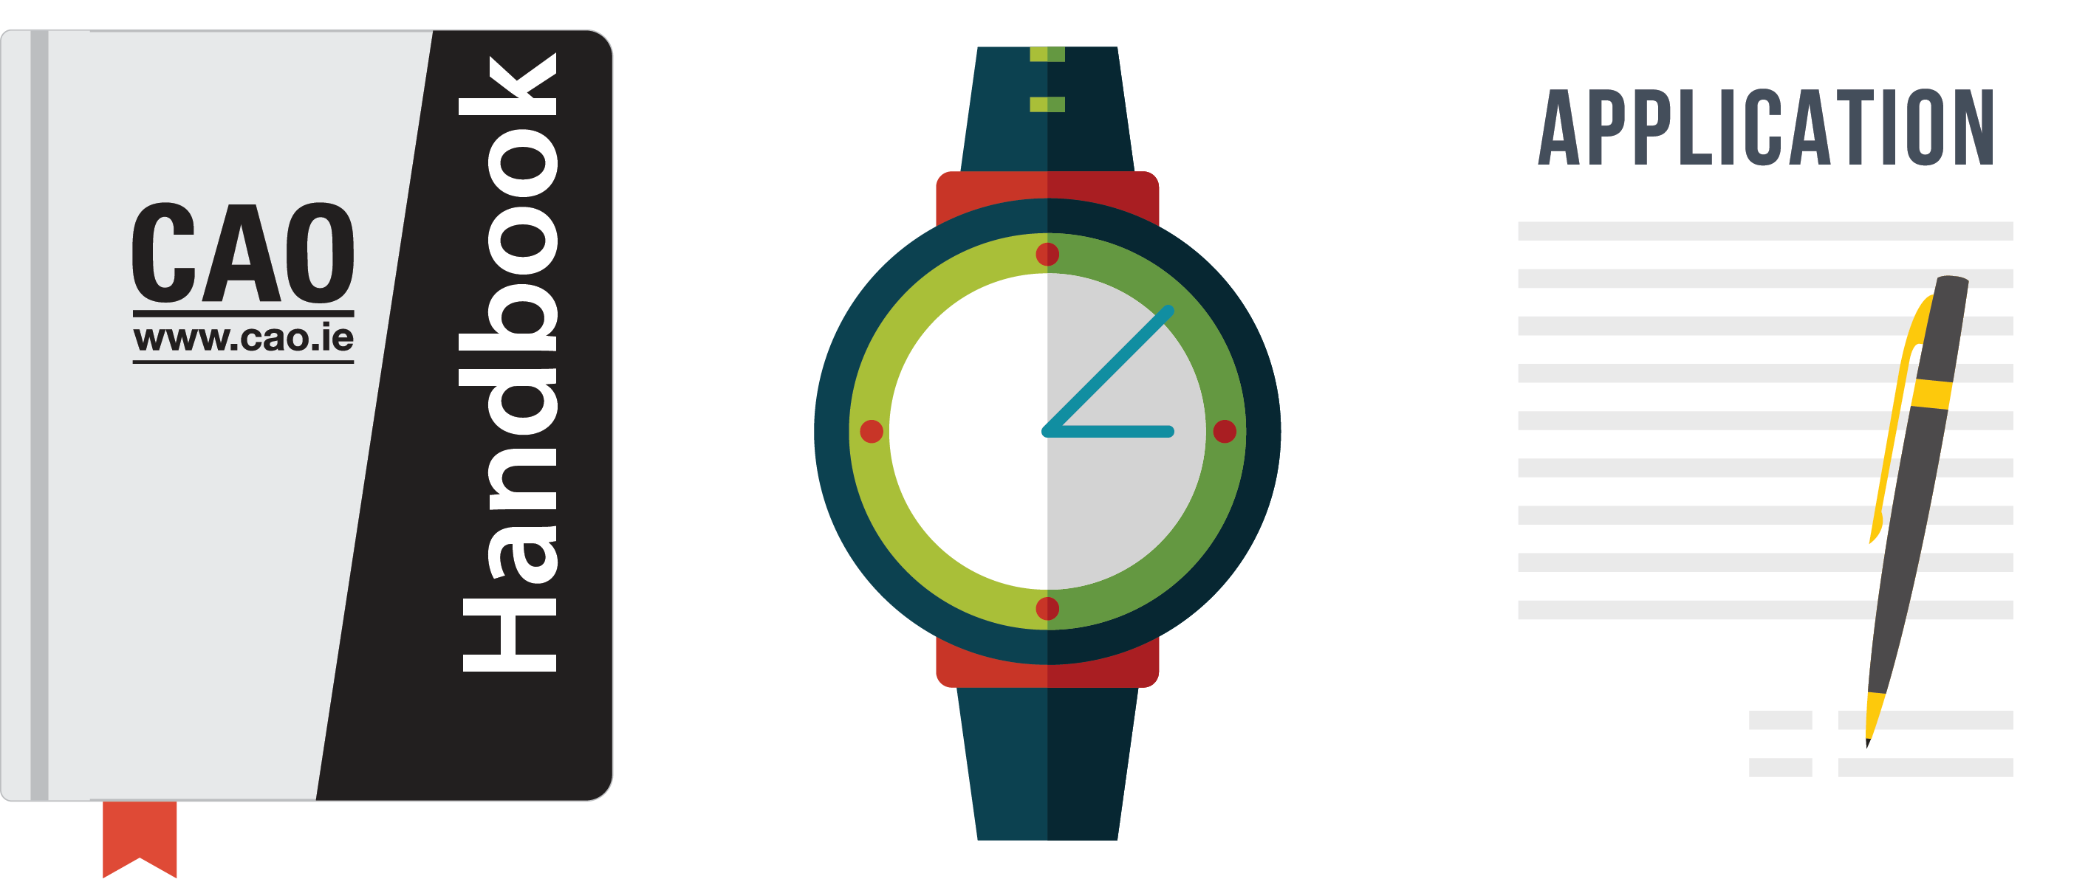
﻿Application Process
www.cao.ie/handbook
www.cao.ie/apply

Slide 4

﻿Timely Action
﻿DO NOT LEAVE
EVERTHING TO
THE LAST
MINUTE!
﻿In order to be fair to all applicants, closing dates
are strict and therefore action should be taken
in good time.

Slide 5
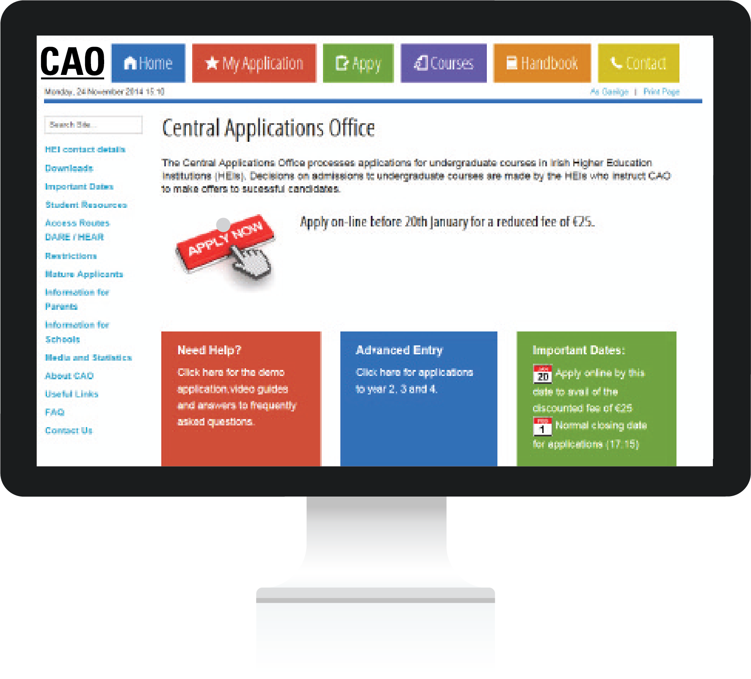
﻿Making an Application
﻿Applicants apply online at www.cao.ie/apply
﻿Carefully enter details such as your name, address, date of birth, schools attended, examination information, etc.
﻿Make sure you inform CAO about all relevant qualifications and exemptions – select the relevant categories on the application form.

Slide 6

﻿CAO Application Number
When you apply online your application number will appear on screen. You will also receive an email containing your CAO application number and an email verification code.
Your application number is private, and it will be used in every correspondence between you and the CAO for the rest of the year.
You will require your CAO application number, date of birth and password when you log in to your account via the ‘My Application’ facility to update your application.

Slide 7
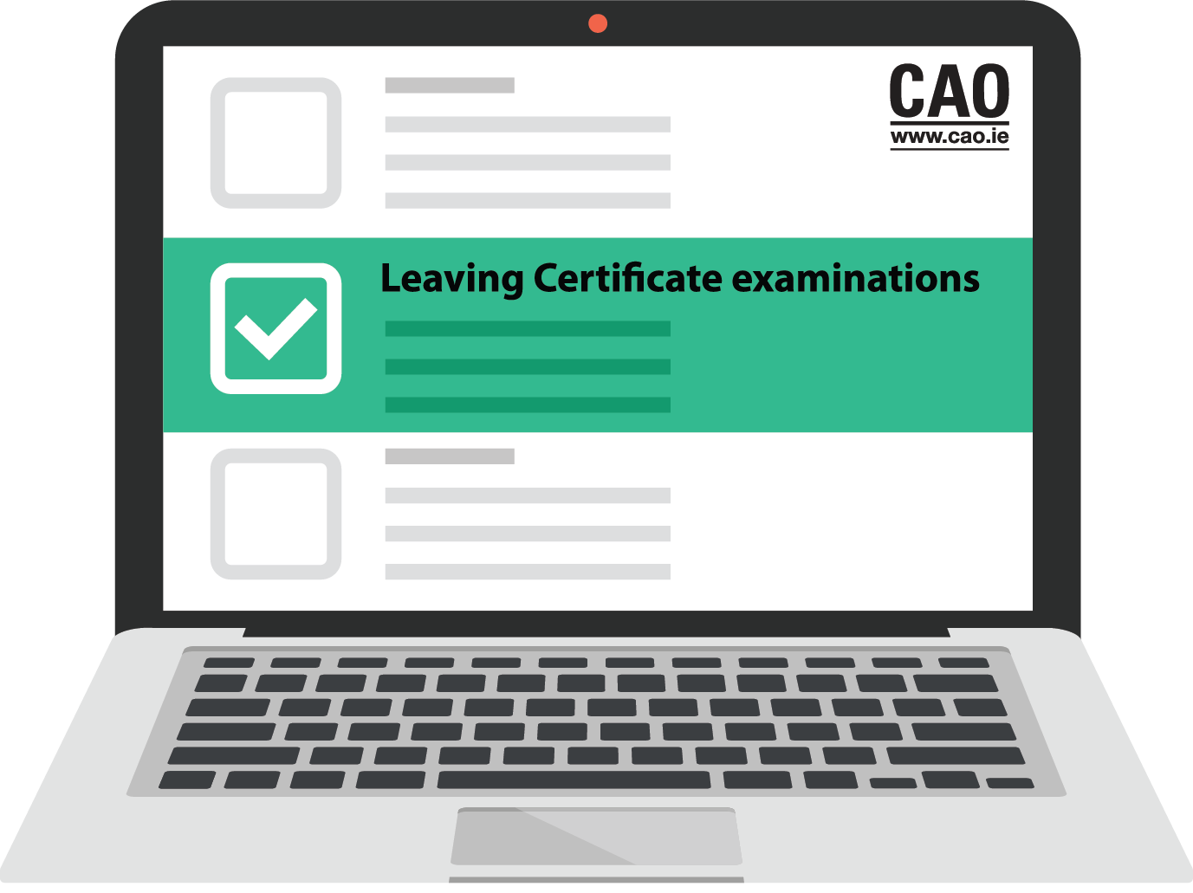
﻿Qualifications & Assessment
You must complete the Qualifications and Assessments categories that are relevant to you.
﻿Applicants presenting GCE A/AS Levels and GCSE examinations should select category 3 ‘GCE A/AS Level & GCSE Applicants (2006 – 2027)’. GCE/GCSE applicants must provide additional information to support their application. Evidence of all examinations mentioned must be supplied.
For more information and for details of the scoring scheme go to www.cao.ie/gce

Slide 8
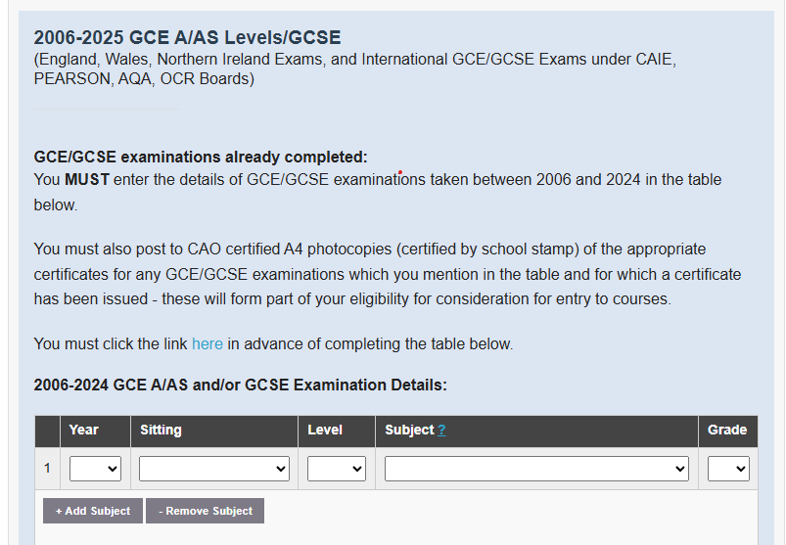
﻿Informing CAO of all GCSE, AS & A Levels
  GCE A/AS Level and GCSE applicants must enter the year, sitting, level, subject and grade for all GCSE, AS and A level examinations previously taken. Note: GCSE results are required to meet minimum entry requirements but are not used for points computation purposes.
Applicants MUST also provide copies of certificates/statements of results produced by an examining board to support their application.
For instructions on uploading your supporting documents see cao.ie/upload. If you wish to post your documents to CAO, please see cao.ie/post for guidance – please do not do both.
If supporting documents are not supplied, the qualifications mentioned will not be considered for assessment purposes.
Copies of certificates/statements of results produced by an Examining Board must be supplied to CAO a minimum of 12 working days in advance of Round One offers.

Slide 9
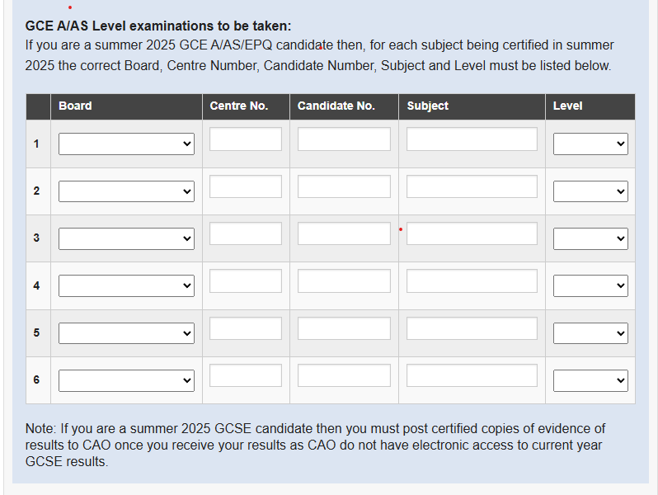
﻿ Qualifications & Assessment
Applicants completing A/AS Level examinations in summer will be asked to insert their 5-digit centre number and 4-digit candidate number for each examination.
You must inform CAO if you are taking your summer examinations with CCEA and/or with British/Welsh examining boards. If we do not have this information, CAO will be unable to obtain your results electronically. This information must be supplied when you are making your CAO application and must be fully and completely correct no later than 23 July.
Detailed instructions for the completion of this part of the application form may be found in the Qualifications and Assessments section of the CAO Handbook.

Slide 10
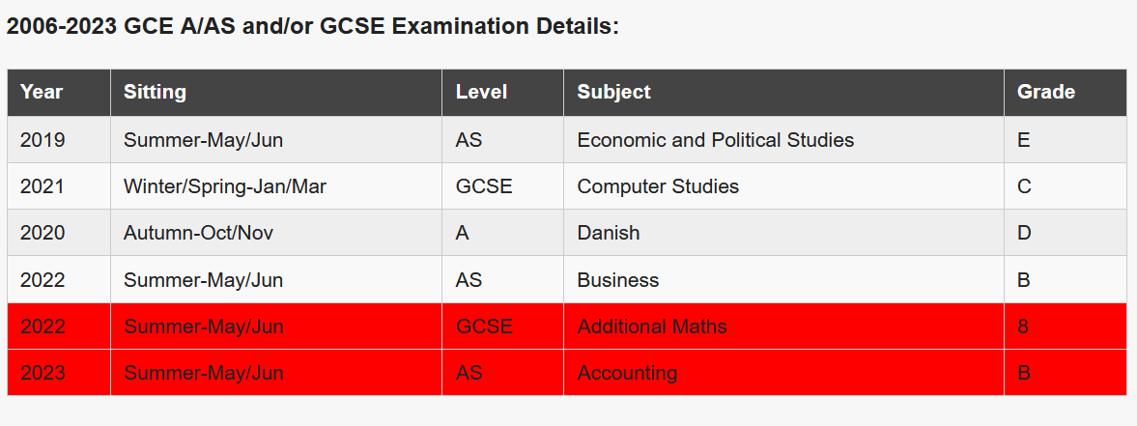
Matching Prior Year Exam Data to Supporting Documentation
When supporting documents are received by CAO, they will be reviewed to ensure they meet the criteria set out in slide 8.
Where correct documents are supplied for all results, the exam data in your online application will be matched.
Results will not be matched where documents do not meet the criteria or where documents are not supplied for prior year exam data included in your online application. Such results will appear in red in your CAO application and will not be considered by the HEIs you have applied to until correct supporting documentation is supplied.
The screenshot above shows a combination of matched results (in grey) and unmatched results which are highlighted in red.

Slide 11
AS Level Results
CAO advises GCE applicants to discuss the AS Level certification process with their school.
AS Level results are frequently cashed in along with A2 Level results in the final year. As a result, candidates often will not have evidence of their AS Level results until the release of their A2 Level results in August.
In this instance, CAO will expect to receive electronic notification of the AS Level results provided that the applicant has supplied their correct Board, Centre Number and Candidate Number for all subjects that will be cashed in in August.
If your school cashes in AS Level results in the same year as A2 Level results, you must enter the remaining AS Level subject which you are not taking at A2 Level on your CAO application – you must use the space provided for ‘Examinations to be taken’ in the Qualifications & Assessments section.
CAO must be informed if the candidate sat any AS or A2 Level examinations at a different school.

Slide 12
Common Errors﻿
Not supplying supporting documentation. (For instructions on uploading or posting documents to CAO go to www.cao.ie/upload or www.cao.ie/post )
Not supplying Board, Centre Number and Candidate Number for current year examinations
Providing documents produced by a school as opposed to an examining board
Not informing CAO of GCSE examination results
Not informing CAO of previously taken AS & A Levels
BTEC Level 1-3 should be listed under Other School Leaving qualifications.
BTEC Level 4 or higher should be listed under Other Further Education.

Slide 13

﻿Choosing Courses
Courses are listed in the CAO Handbook at www.cao.ie/handbook
Details about courses may be found in HEI prospectuses and by consulting HEI websites.
A course search facility is available at www.cao.ie/courses

Slide 14
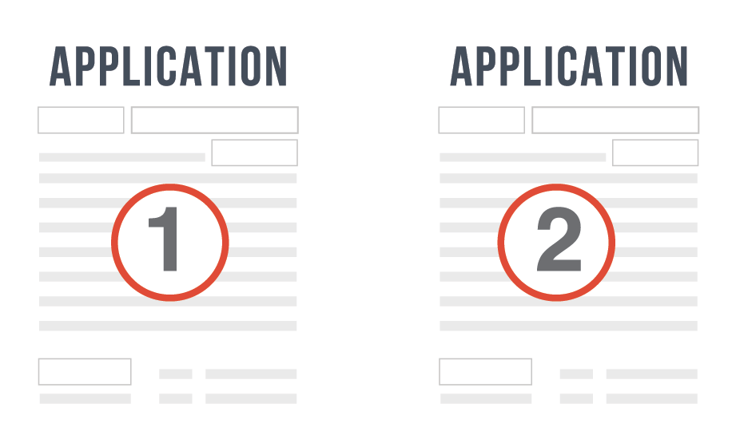
﻿Level 8 and Level 7/6 Courses
The National Framework of Qualifications (NFQ) is a system of 10 levels which allows the different standards and levels of qualifications to be compared in the Republic of Ireland.
CAO process applications for Levels 6-8 in the Framework:
  Level 6 courses result in the awarding of a Higher Certificate
  Level 7 courses result in the awarding of an Ordinary Degree
  Level 8 courses result in the awarding of an Honours Degree
A diagram of the NFQ is on the website of the Quality and Qualifications Ireland (QQI) www.qqi.ie.
For more information see the CAO Handbook.

Slide 15
﻿2 Applications in 1
There are two course choice lists (Level 8 and Level 7/6) and applicants may make up to 10 course choices on each list.
Your choices on one list do not in any way affect your choices on the other list. They may be considered two separate applications on one form.
It is possible to receive an offer on both lists. You may then decide to accept either your Level 7/6 or your Level 8 offer.
Alternatively, you might not wish to accept either offer.

Slide 16
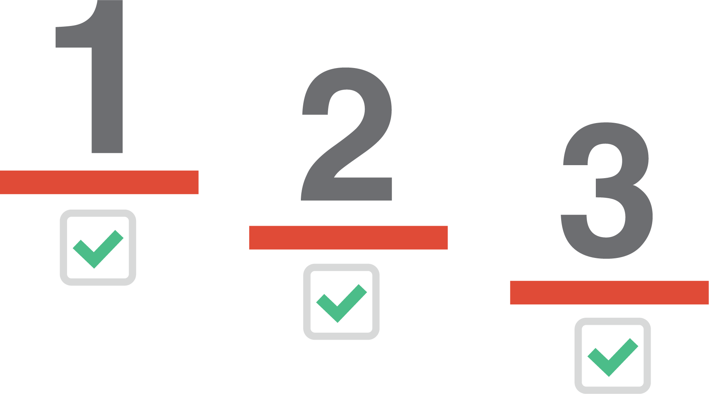

Important
﻿If you learn nothing else from this presentation let it be this...
﻿PLACE YOUR COURSES IN GENUINE ORDER OF PREFERENCE!
﻿To do otherwise is a grave mistake.

Slide 17
﻿Order of Preference
It is most important that applicants state their course choices in order of genuine preference and/or career plans.
It is a mistake to base course choices only on your present expectations of examination performance or the points level of previous years.
If you are not successful in your first choice this will have no effect on your chances of obtaining a place in one of your lower preferences.
Having received an offer in any round, you may get a higher preference offer in a later round. You will never be offered a lower preference in a later round.

Slide 18
﻿Restrictions
Certain courses are ‘Restricted Courses’. They have early assessment procedures which may start as early as February.
This includes courses such as Music, Art and Drama which may require interviews, assessments or presentation of a portfolio as part of the application process.
Restricted courses are clearly marked in the relevant prospectus and on the CAO Handbook (by the words 'Restricted').
An application for a Restricted Course will not be considered unless:
a) it has been included among original course choices by 1 February b) it has been added to an existing application not later than the final date for correction of errors or omissions (1 March).
Please see the ‘Restrictions’ section of the CAO Handbook for further information.

Slide 19

﻿Change of Mind Facility
﻿You may use this facility to change the order of your course choices and/or to introduce new courses, subject to the restrictions detailed in the handbook.
The Change of Mind opens in early May and closes on 1 July at 5pm.

Slide 20

﻿Check and Confirm E-mail
﻿Before the end of May, all applicants will be sent a Check and Confirm email to enable you to verify that all information has been recorded completely and correctly. Check the following carefully, and if there is any error or omission, update your account without delay.
﻿If you do not
receive a
Check and
Confirm email by
Are all the courses shown and in the correct order?
Are all the codes correct?
Are the exam numbers and years correct?
Are all exams mentioned?
Are all exemptions listed?
contact CAO immediately.

Slide 21

﻿When the results are released
﻿In the days following the release of the A Level results CAO will email all GCE/GCSE applicants.
Applicants must read this email carefully and inform CAO immediately if any details are incorrect or missing.
Applicants must supply (by upload or post) a copy of any missing results as soon as possible. For more information on submitting documents go to www.cao.ie/upload or www.cao.ie/post
Documents must be produced by the exam board i.e. they must show the exam board logo, and show the sitting, level, subject and grade awarded.

Slide 22

﻿Offer Notifications
﻿If you are entitled to an offer, you will be sent an e-mail and SMS text message if you have selected this option.
You should check that all the details on the offer notification are correct and that there are no omissions.
Offers will also be available on the CAO website.
You may check for and accept offers on the website.

Slide 23

﻿Accepting an Offer
﻿There can be no delays at the offer/acceptance stage.
Any offer not accepted by the closing date for receipt of acceptance of offers in CAO will be offered to another applicant in the next round of offers.
You will receive an e-mail acknowledging your acceptance if you accept online.

Slide 24
How the Allocation Process works
﻿We will look just at Level 8 courses, but exactly the same process will take place with Level 7/6 courses, and at the same time.
The importance of you, the applicant, placing courses in genuine order of preference will become apparent in the following pages.

Slide 25
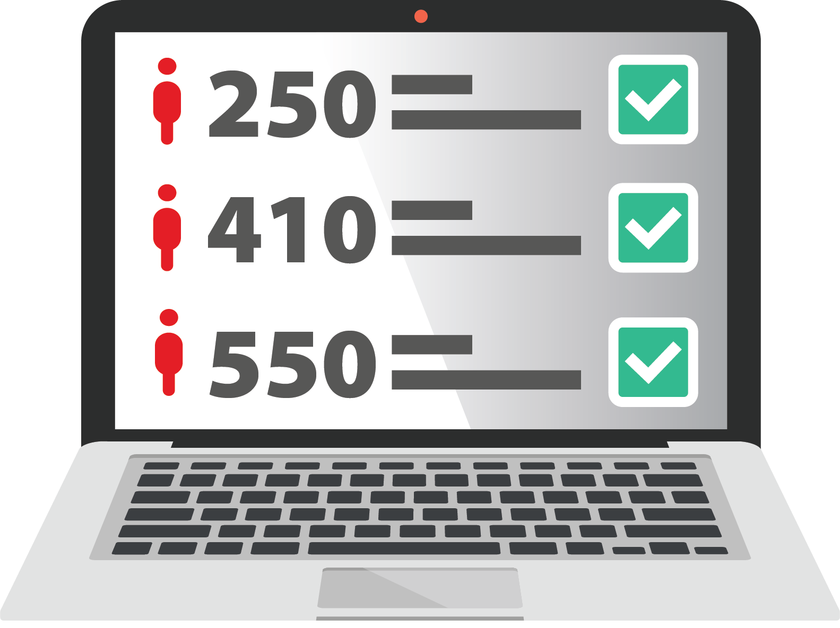
﻿Minimum Entry Requirements
﻿When examination results are released in August they are entered into the CAO computer.
The computer checks each applicant’s results.
﻿For each course the applicant has applied for,
the computer first determines if the applicant has the minimum entry requirements for the course.

Slide 26
﻿Order of Merit List
﻿If the applicant meets the minimum entry requirements for the course, the applicant’s points are calculated for this course choice.
﻿To view how to calculate your points go to the Applicants section of
www.cao.ie or see the CAO Handbook.
﻿All eligible applicants are then placed on a list, in order of academic merit, for each course that they applied for.
Minimum Entry Requirements + Points Score = Position on Order of Merit List

Slide 27

Allocation Process
﻿The admissions officers of the Higher Education Institutions tell CAO how many places are to be offered on each course.
CAO then makes offers to the required number of applicants on each course, starting with the applicant with the highest points and working down until enough places have been offered.

Slide 28

﻿Additional Offers
﻿﻿Should some applicants decline to accept their offers these places become available in the next round of offers.
They will be offered to the next applicants on the Order of Merit list. This process continues until all of the places on the course are filled or until all the eligible applicants on the Order of Merit list have been offered places.

Slide 29

﻿Allocation Process Example
﻿EXAMPLE
– no results yet!
﻿These are the applicants for CK101 - Arts in UCC.
The examination results have not yet been released, so these applicants are in no particular order.
We are going to trace the progress of the applicant marked in red.

Slide 30
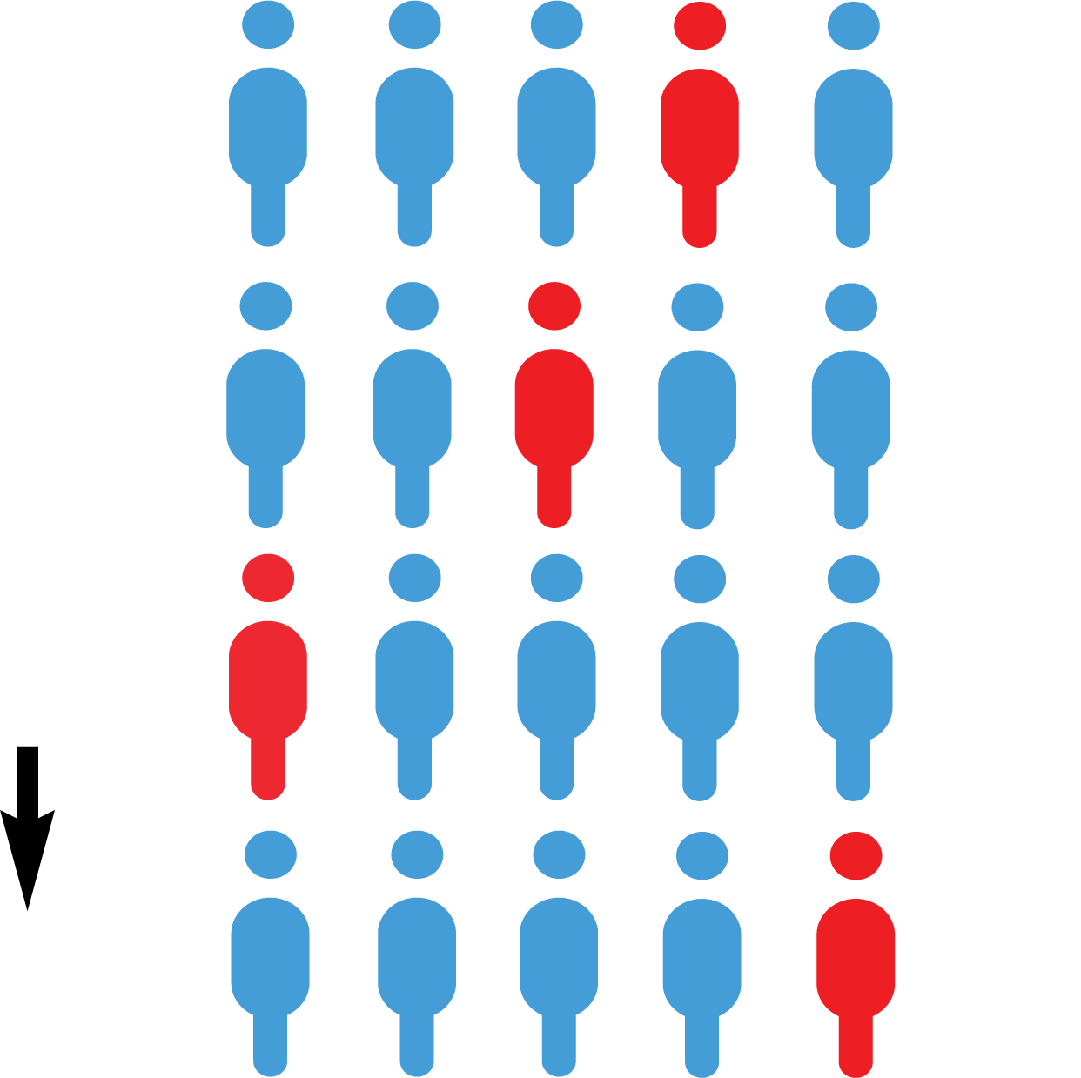
﻿Example - After the results are released
﻿EXAMPLE
– Exam results have been released.
﻿1. CK101
﻿2. DN201
﻿Applicants are placed in a queue for each course they applied for - their position in the queue is determined by their points.
The applicant with the highest points is placed at the top of the queue. The points achieved by the applicant in red determines her position in the queue for each course she has applied to.
﻿3. AL850
﻿10. LM040

Slide 31

﻿Example – Round 1 Offers
﻿EXAMPLE
– HEIs issue R1 offers
﻿1. CK101
﻿2. DN201
﻿The applicants marked in GREEN have enough points to be offered places.
The applicant marked in RED has enough points for her second preference.
﻿3. AL850
﻿10. LM040

Slide 32

Decision-making
﻿1. CK101
﻿EXAMPLE
– HEIs issue R1 offers
﻿1. CK101
﻿2. DN201
﻿﻿The applicant in RED is offered her second preference, the highest preference course that she has enough points for, and she will now disappear from the queue for all her lower choices.
Placing DN201 as her second preference meant that she would prefer to receive an offer on DN201 than on any other course except CK101 - which is her first preference.

Slide 33

﻿Round 2 Offers
﻿1. CK101
﻿EXAMPLE – R2 offers
﻿1. CK101
﻿After Round 2 offers are issued, our applicant is now in first place on the waiting list for her first preference course.
She has already accepted her 2nd preference course. Accepting or not accepting her 2nd preference course will not prevent her from receiving an offer of her 1st preference course if she is deemed eligible by the institution in a later round.

Slide 34

﻿Round 3 Offers
﻿1. CK101
﻿EXAMPLE
– An offer is issued in R3 for her 1st preference!
﻿1. CK101
﻿In the third round of offers two more offers are made on CK101 and our applicant, who was at the top of the queue, now receives an offer.
She may do nothing and remain in DN201, or she may accept the offer.

Slide 35

﻿Genuine Order of Preference
﻿You do not need to guess what the points are going to be for the courses you are interested in.
Simply list your courses in genuine order of preference from the highest preference 1, to the lowest preference 10.
If you are entitled to an offer, you will be offered the highest preference that you are entitled to.

Slide 36
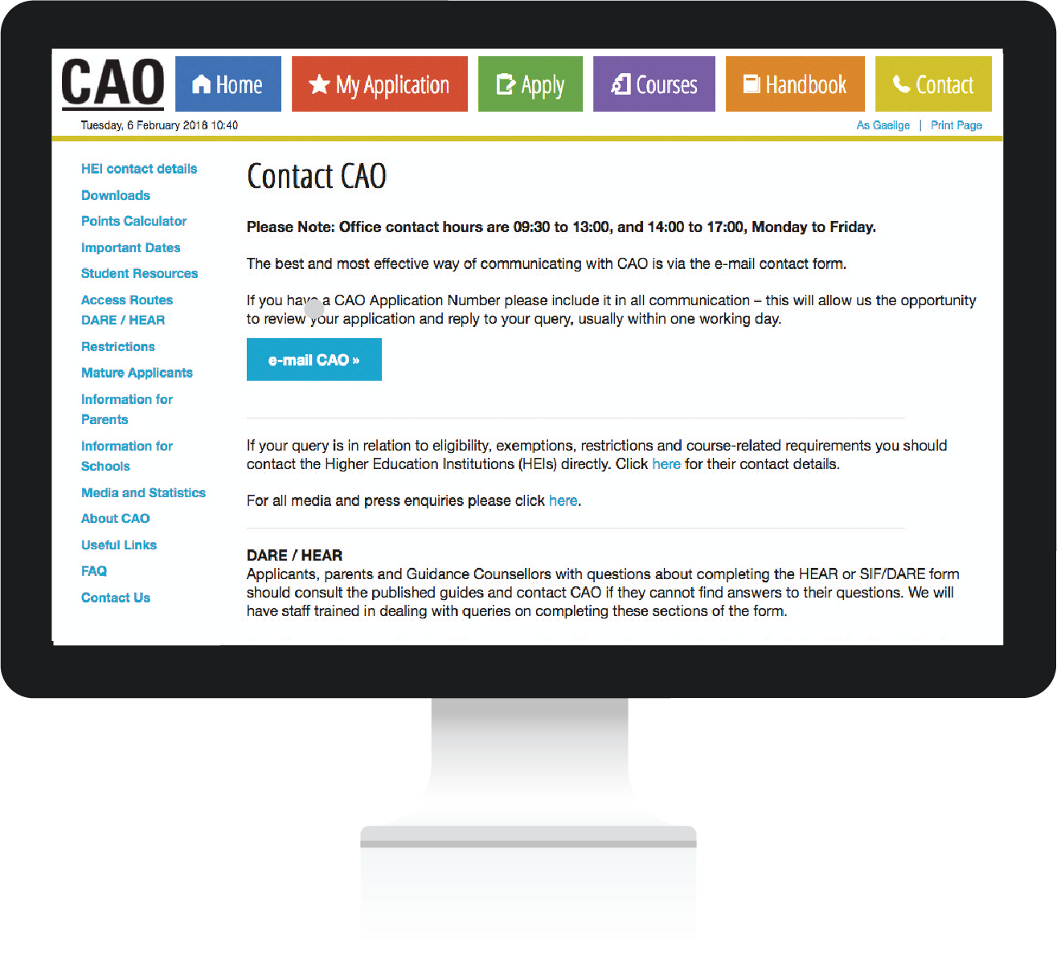
﻿Communication with CAO
﻿The easiest and most efficient way to communicate with CAO is by using the Correspondence Section of your CAO Account. You will receive a reply to your query usually within one working day.
Always quote your CAO application number in any communication with CAO.
For information on uploading documents to CAO, please see cao.ie/upload. If an applicant chooses to post documents to CAO, they will find information at cao.ie/post

Slide 37
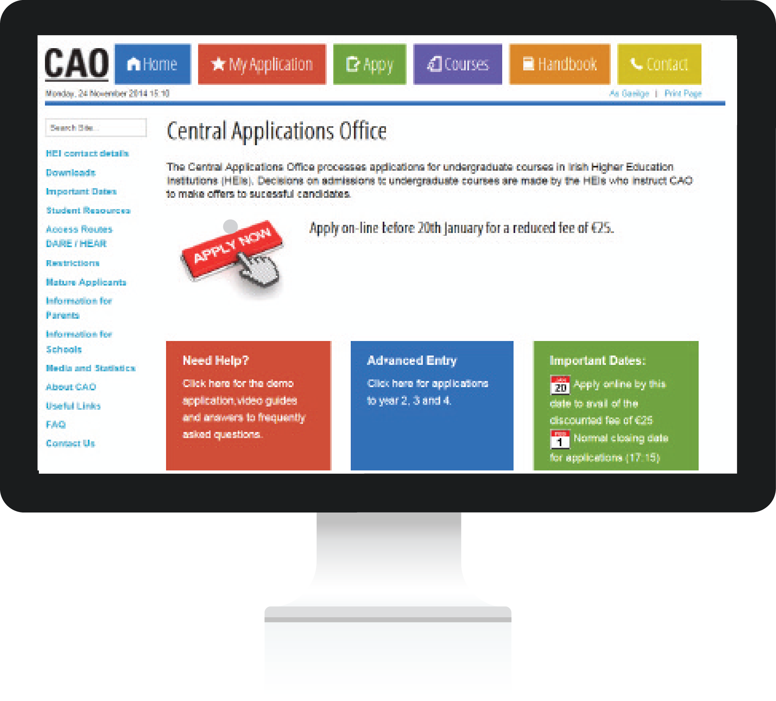
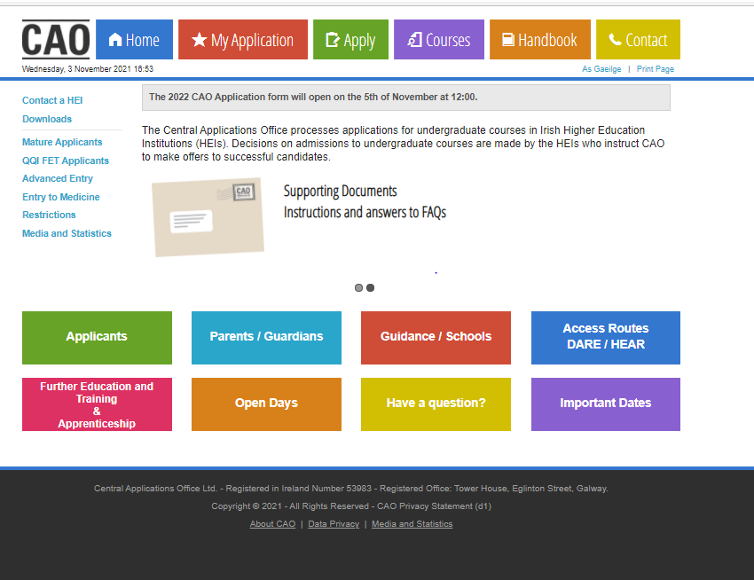
﻿Useful Resources
﻿An online copy of the
CAO Handbook is
available here
﻿﻿Visit the ‘Applicants’ section for Video Guides and useful resources including the ‘Demo Application’ facility.
﻿Watch this space for
‘Important Dates’.

Slide 38

﻿Finally...
﻿Remember to carefully
read all of the documents and instructions
from CAO.
﻿Most applicants follow
the simple instructions
from CAO and get
along just fine.
﻿If you are unclear on any matter concerning the application process, please contact us via our
website: www.cao.ie

