Slide 1
Parents Guide 2027

Slide 2

﻿Introduction
﻿﻿This presentation has been prepared by the Central Applications Office (CAO) to assist parents and guardians supporting a student in their undergraduate application to Irish Higher Education Institutions (HEIs).
The CAO is responsible for processing applications and recording acceptances for HEIs, but all decisions on admissions are made by the individual institutions and not by CAO.
Students must carefully read the CAO Handbook, available at www.cao.ie/handbook, which contains information on all of the courses, restrictions, deadlines, fees and application guidelines. A personalised version of the handbook is also available.
All students should also seek the advice of their school guidance counsellor before completing their CAO application.

Slide 3

﻿﻿Your role as a parent/guardian
﻿Encourage your
child to apply
early
﻿Make sure your
child lists their
courses in
genuine order of
preference
﻿Help your
child to
research
their courses
﻿Watch out for
important
deadlines
﻿Remind your
child to review
all CAO
correspondence
carefully
﻿Accept offer online
by the reply date

Slide 4

﻿Helping your child to choose their higher education courses
Courses are listed in the HEI prospectuses, the CAO Handbook can also be searched for using the ‘Courses’ facility at www.cao.ie/courses
Make sure to check for minimum entry requirements.
Watch out for restrictions – see page 3 of the CAO Handbook.
Talk to family members and friends, especially those who have attended the institution or who have studied the course of interest.
Consider the financial implications - the cost of accommodation, food, and travel expenses for every year of study.

Slide 5
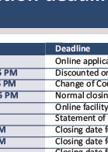
﻿ ﻿The application deadlines
Date | Deadline
Early November | Online application facility opens
20 January 5pm | Discounted online application fee deadline – €35 fee
1 February 5pm | Change of Course Choices closes
1 February 5pm | Normal closing date for online and paper applications - €50 fee
Early February | Online facility to amend course choices opens – fee of €10
1 March 5pm | Closing date for amending course choices – fee of €10
1 March 5pm | Closing date for final completion of HEAR/DARE forms
10 March 5pm | Closing date for HEAR/DARE documentation to be received by CAO
1 May 5pm | Closing date for late applications - €65 fee
Early May | Online Change of Mind facility becomes available
End of May | Check and Confirm e-mail sent to all applicants
1 July 5pm | Change of Mind closes

Slide 6
﻿Restrictions
﻿﻿﻿RESTRICTED COURSES
﻿RESTRICTED CATEGORIES OF APPLICANT
﻿﻿HEAR
SOCIO ECONOMIC DISADVANTAGE
﻿DARE
DISABILITIES/SLD
﻿Applications must be made by 1 February at 5PM. Consult CAO Handbook for full details.

Slide 7
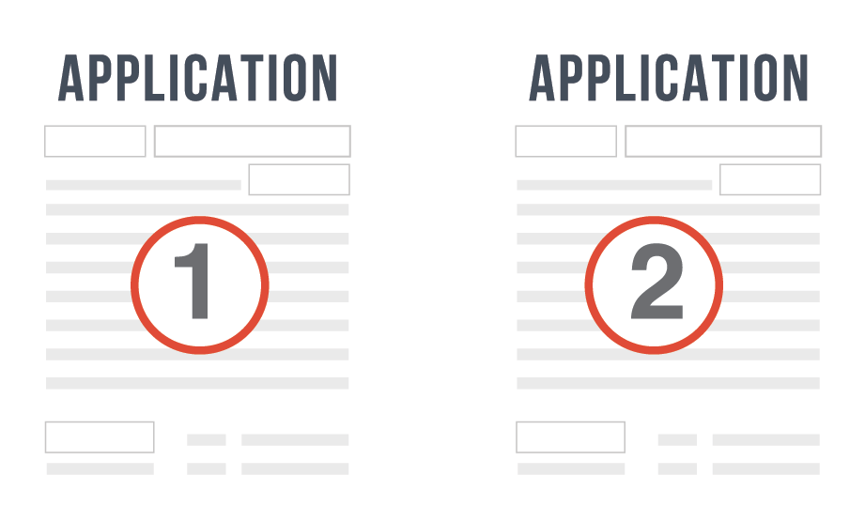
﻿2 Applications in 1
There are two course choice lists (Level 8 and Level 7/6) and applicants may make up to 10 course choices on each list.
Your choices on one list do not in any way affect your choices on the other list. They may be considered two separate applications on one form.
It is possible to receive an offer on both lists. You may then decide to accept either your Level 7/6 or your Level 8 offer.
Alternatively, you might not wish to accept either offer.

Slide 8

﻿﻿Completing the application form
﻿Use the Demo Application facility in the Applicants section of the website to become more familiar with the process before starting an application (www.cao.ie/demo)
Apply online via www.cao.ie
Enter personal details carefully, particularly date of birth and email address.
Once registered on the system, applicants will receive an application
number which must be kept safe. This number will be needed for
all future correspondence with CAO.
Applicants should check emails regularly for correspondence from CAO and/or
the HEIs.
Applicants must remember to place course choices in genuine order of preference.

Slide 9

﻿﻿﻿Important correspondence from CAO
﻿All correspondence from CAO should be treated as extremely important and checked carefully to make sure that the information held on file by CAO is correct.
When your child applies online, their first correspondence with CAO will be in the form of an automated email which will contain your child’s application number and a verification code.
Before the end of May, all applicants will receive a Check and Confirm email. This is an extremely important email, and instructions must be followed carefully, and any errors or omissions must be rectified immediately.
At the offers stage your child will either receive an Offer or a Check and Confirm email.
If they receive a Check and Confirm email, this is because they have not been deemed eligible for an offer in this round. You must ensure that your child checks that all the information that CAO currently holds on file is correct, including their examination details.

Slide 10

﻿Making amendments to a CAO application
Date | Deadline
Early November - 1st February 5pm | Change of Course Choices facility available online (FREE)
Early February - 1st March 5pm | Online facility to amend course choices available (FEE: €10)
Early May – 1st July 5pm | Change of Mind facility available (FREE)
﻿It is important to note that there are restrictions on introducing courses using the Change of Mind facility - page 3 of the CAO Handbook outlines these restrictions.
There are several deadlines that must be noted when your child is making amendments to their CAO application. Your child may change some of their personal information (e.g. postal address, telephone number and email address) online using the My Application facility. To change their name, date of birth or to add an examination category to their application, they must email CAO via the Correspondence Section of their account.

Slide 11

﻿The offers stage
﻿There are three main rounds of offers: Round A, Round Zero, and Round One.
If your child is applying on the basis of school leaving examination results, regardless of the year completed, they may receive an offer in Round One.
Round One offers will be issued as soon as possible after the current year Irish Leaving Certificate Examination results become available.
After Round One offers have been accepted, CAO then issues
Round Two offers for remaining places.
Subsequent offers are issued by CAO as necessary until the end of
September to fill any vacancies that may arise.

Slide 12
﻿The offer rounds
Date | Deadline
Round A (early July) | Deferred applicants; mature applicants; mature nursing/midwifery applicants; and applicants who have completed an access course.
Round Zero (early August) | Graduate entry medicine applicants; additional mature, deferred and Access applicants; and applicants presenting QQI FET/FETAC for consideration for entry to courses with a quota for QQI FET/FETAC applicants.
Round One (late-August) | All applicants applying on the basis of school leaving examination results, regardless of year completed (including applicants presenting QQI FET/FETAC qualifications for non-quota courses).
Round Two and subsequent offers (late-August to end Sept.) | All applicants applying on the basis of school leaving examination results, regardless of year completed.

Slide 13
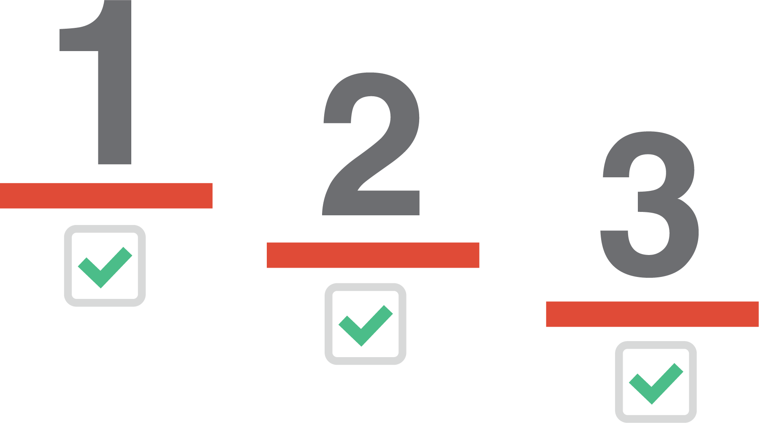
﻿Entry requirements
﻿After the release of the Leaving Certificate results, the examination results are input into the CAO computer and for each course that your child applied for the
CAO will first check that they meet the minimum
entry requirements.
If your child meets the eligibility criteria for the course(s) that they have applied for, the system then calculates a points score using the HEI Common Points Scale.

Slide 14
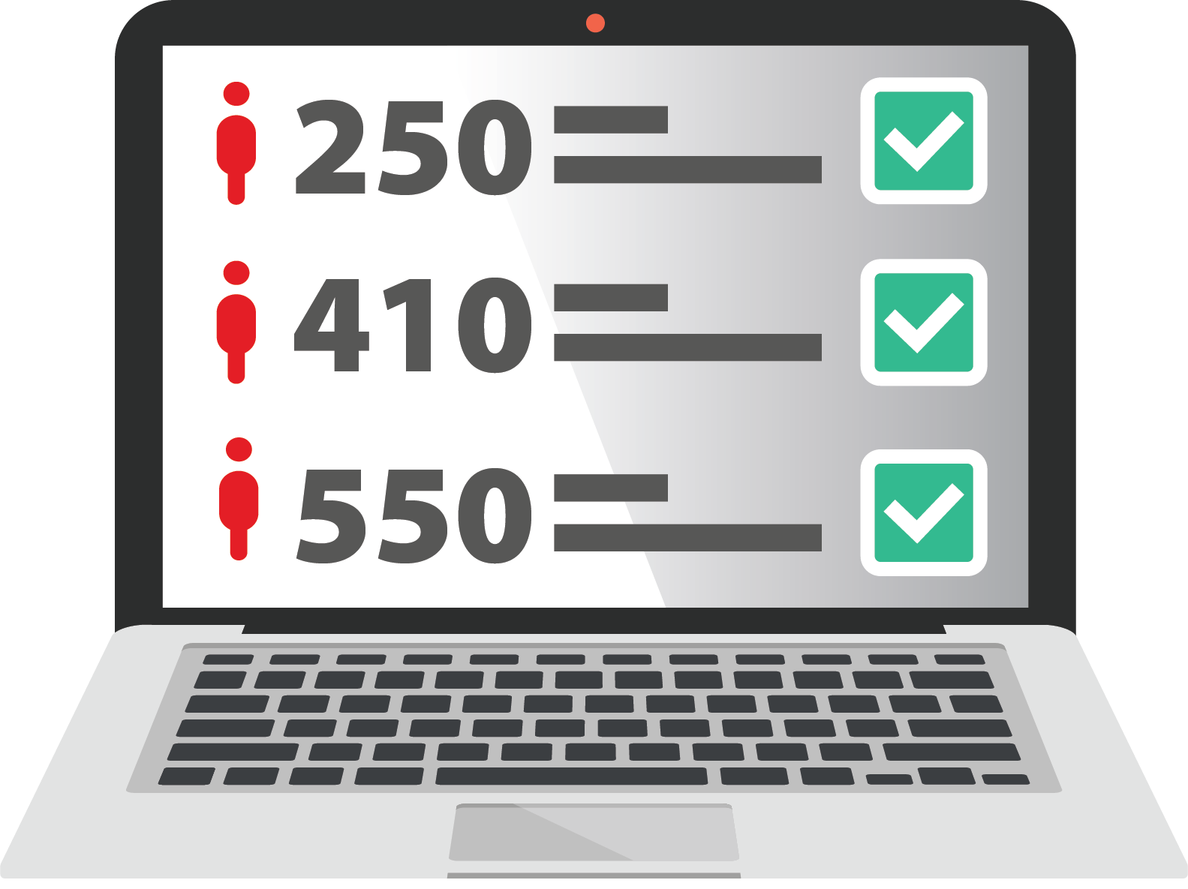
﻿How offers are issued
Your child will then be placed on a list in order of merit for each course that they are eligible for e.g., if your child has the highest points score he/she goes to the top of the list and the child with the second-highest points score goes second on the list, and so on.
The HEI then instructs CAO on how many offers to make for each course. If your child was in 20th position for a chosen course, and the institution instructs CAO to offer 25 places, then your child will receive an offer of a place on that course (unless they have received an offer of a course higher up on their preference list). The points score of the applicant in 25th place will be published as the cut-off points for that course in that round.

Slide 15

﻿Accepting an offer
﻿If your child decides to accept an offer, they can accept the offer online up to the
reply date.
If they receive an offer from both lists, they must choose between them; they can
only accept one offer from either their Level 8 or their Level 7/6 list.
Accepting an offer in Round One does not mean that your child will be prevented from receiving an offer of a higher preference course in subsequent offer rounds. Should a place become available in a later round, and if your child is entitled to this place, they may receive an offer which they can choose to accept or ignore. Accepting the new offer will automatically cancel the previous acceptance.

Slide 16
﻿Deferring a place
﻿If your child decides to defer an offer of a place they must e-mail immediately to the Admissions Office of the appropriate HEI. They should not accept their CAO offer.
They must give their name as it appears on their CAO application, quote their CAO application number and the course code of the offer they wish to defer, and set out the reason(s) for the request. They must mark “DEFERRED ENTRY” clearly in the Subject Line of their e-mail.
The e-mail must arrive in the Admissions Office at least two days before the “Reply Date” shown on the Offer Notice.
The HEI will communicate their decision to your child. If the deferral is not granted, your child may then accept the offer for the current year providing they record the acceptance by the reply date.

Slide 17

﻿The recheck process
﻿If your child has requested to have some of their Leaving Certificate examinations rechecked, and if the recheck discovers that your child deserved a higher mark and thus obtains a higher points score, their position on the Order of Merit list will be altered to reflect their new points score.
The decision to offer a place to a recheck applicant is made by the HEI in question and not the CAO.

Slide 18
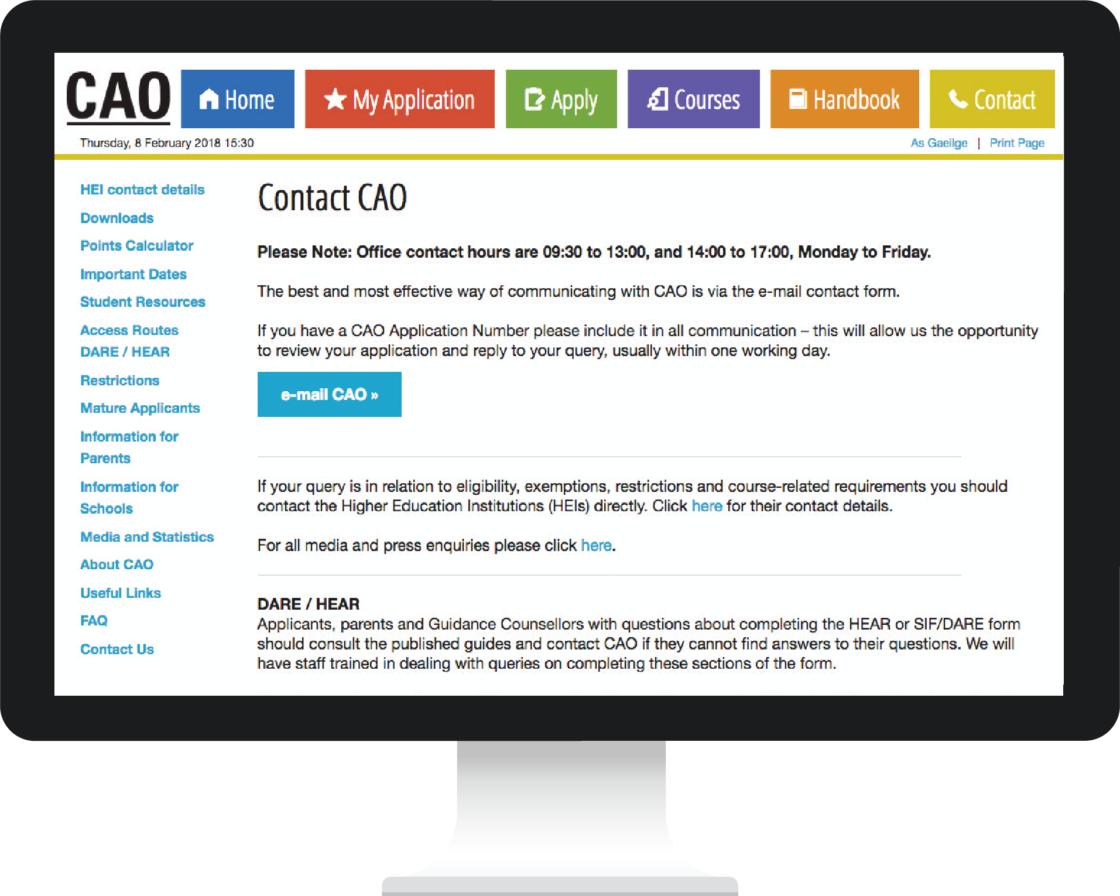
﻿Communicating with CAO
﻿﻿The easiest and most efficient way for your child to communicate with CAO is by using the Correspondence Section of their CAO Account. They should give us as much information as possible and they will receive a reply to their query, usually within one working day.
Applicants should always quote their CAO application number in any communication with CAO.
If you post something to CAO always obtain a certificate of posting at the post office. This is a free service and it offers you peace of mind.

Slide 19
﻿﻿Useful resources
﻿Please visit www.cao.ie and click on the ‘Parents/Guardians’ page to view some of the useful resources available, including:
﻿- The Demo Application Facility www.cao.ie/demo
﻿- Video Guides www.cao.ie/video
﻿- A guide to the CAO for parents and guardians
﻿- Timetable of Events
﻿- The CAO Handbook www.cao.ie/handbook

