Slide 1
The Available Places facility
Adding Available Place courses to a CAO application

Slide 2
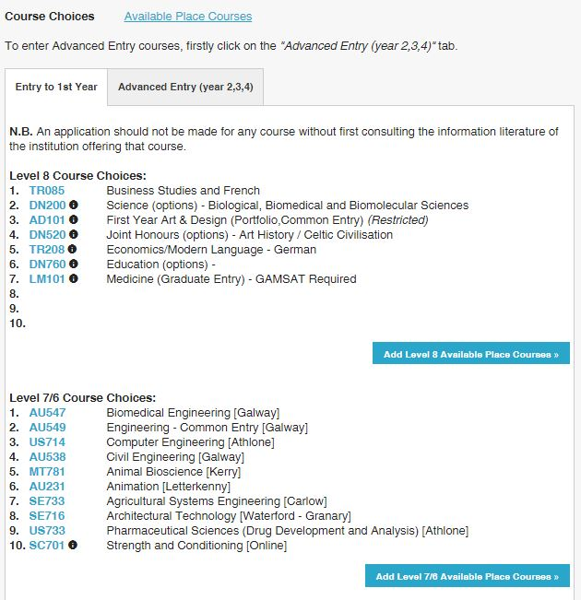
Course Choices section of an applicant’s account (when Available Places facility opens)

Slide 3
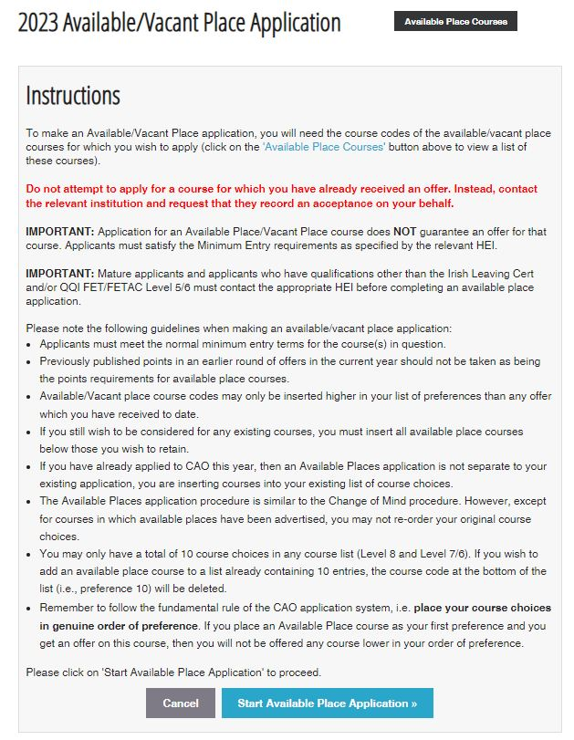
Instructions that the applicant will see when they click on ‘Add Available Place Course’

Slide 4
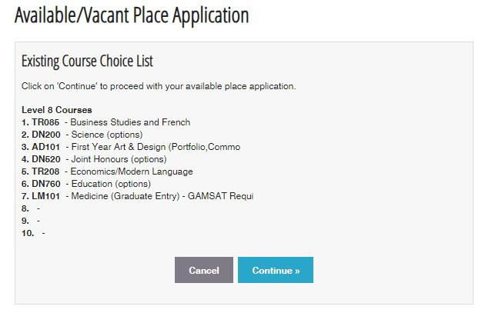
After clicking on ‘Start Available Place Application’ the applicant will see their Existing Course Choice List. The same process applies for both the Level 8 and Level 7/6 list.

Slide 5
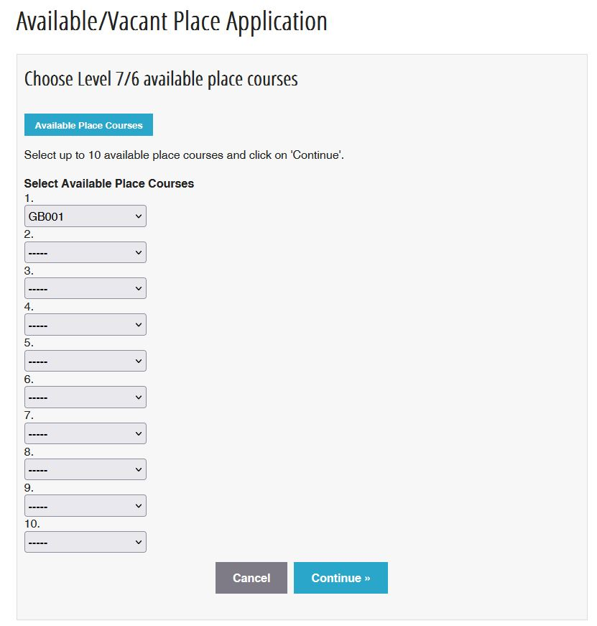
After clicking on ‘Continue’ the applicant will be brought to the following screen where they can select up to 10 Available place courses – to view courses available for application, click on the ‘Available Place Courses’ tab

Slide 6
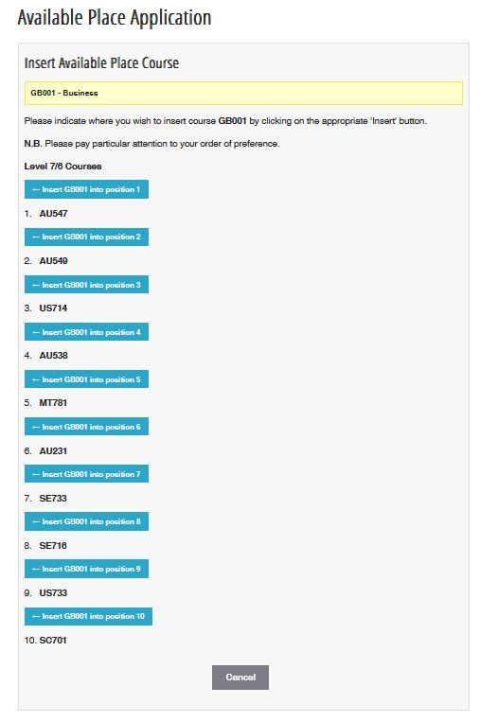
After selecting Available Place courses and clicking on ‘Continue’, the applicant will be asked where they want to insert each of the Available Place courses indicated in the previous step. The Available Place course insertion is dealt with on a course-by-course basis.

Slide 7
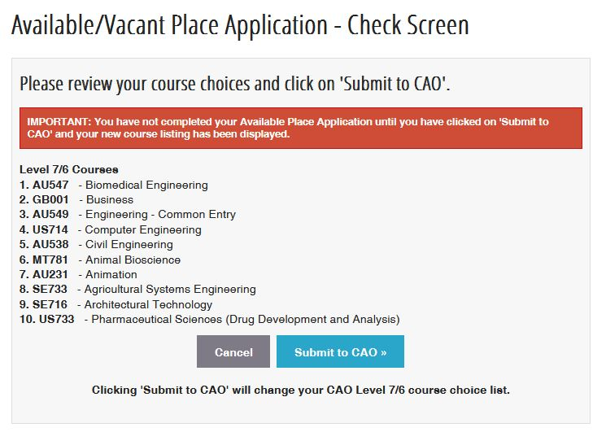
After the applicant has inserted the Available Place courses into the relevant positions and clicked on ‘Submit to CAO’ the following ‘Check Screen’ will appear.
If the applicant is happy with the position of the courses, they should click on ‘Submit to CAO’ to complete the Available Places application

Slide 8
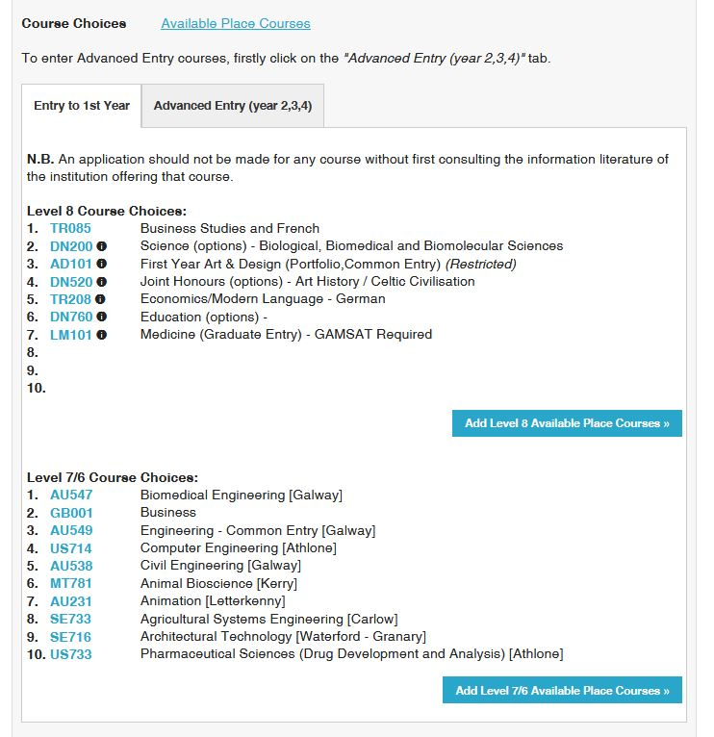
After clicking on ‘Submit to CAO’ the following screen will appear. If the applicant is unhappy with their list, they can repeat the steps (if the Available Places facility is still available)

Slide 9
Remember:
If you still wish to be considered for any existing courses, you must insert all Available Places courses below those you wish to retain.
Available Places course codes may only be inserted higher on your list of preferences than any offer which you have received to date.
You may only have a total of 10 course choices in any course list (Level 8 and Level 7/6). If you wish to add an Available Places course to a list already containing 10 entries, the course code at the bottom of the list (i.e., preference 10) will be deleted.
For existing CAO applicants, it is important to remember to follow the fundamental rule of the CAO application system, i.e. place your course choices in genuine order of preference.
If you place an Available Places course as your first preference and you get an offer on this course, then you will not be offered any course lower in your order of preference.
The Available Places application procedure is similar to the Change of Mind procedure. However, except for courses in which Available Places have been advertised, you may not re-order your original course choices.

